Slide 1
13
Object-Oriented
Programming:
Polymorphism

Slide 2
One Ring to rule them all, One Ring to find them,
One Ring to bring them all and in the darkness bind them.
  John Ronald Reuel Tolkien
The silence often of pure innocence
Persuades when speaking fails.
  William Shakespeare
General propositions do not decide concrete cases.
  Oliver Wendell Holmes
A philosopher of imposing stature doesn’t think in a vacuum. Even his most abstract ideas are, to some extent, conditioned by what is or is not known in the time when he lives.
  Alfred North Whitehead

Slide 3
OBJECTIVES
In this chapter you’ll learn:
What polymorphism is, how it makes programming more convenient, and how it makes systems more extensible and maintainable.
To declare and use virtual functions to effect polymorphism.
The distinction between abstract and concrete classes.
To declare pure virtual functions to create abstract classes.
How to use run-time type information (RTTI) with downcasting, dynamic_cast, typeid and type_info.
How C++ implements virtual functions and dynamic binding "under the hood."
How to use virtual destructors to ensure that all appropriate destructors run on an object.

Slide 4
13.1 Introduction
13.2 Polymorphism Examples
13.3 Relationships Among Objects in an Inheritance Hierarchy
13.3.1 Invoking Base-Class Functions from Derived- Class Objects
13.3.2 Aiming Derived-Class Pointers at Base-Class Objects
13.3.3 Derived-Class Member-Function Calls via Base- Class Pointers
13.3.4 Virtual Functions
13.3.5 Summary of the Allowed Assignments Between Base-Class and Derived-Class Objects and Pointers
13.4 Type Fields and switch Statements
13.5 Abstract Classes and Pure virtual Functions

Slide 5
13.6 Case Study: Payroll System Using Polymorphism
13.6.1 Creating Abstract Base Class Employee
13.6.2 Creating Concrete Derived Class SalariedEmployee
13.6.3 Creating Concrete Derived Class HourlyEmployee
13.6.4 Creating Concrete Derived Class CommissionEmployee
13.6.5 Creating Indirect Concrete Derived Class BasePlusCommissionEmployee
13.6.6 Demonstrating Polymorphic Processing
13.7 (Optional) Polymorphism, Virtual Functions and Dynamic Binding "Under the Hood"
13.8 Case Study: Payroll System Using Polymorphism and Run-Time Type Information with Downcasting, dynamic_cast, typeid and type_info
13.9 Virtual Destructors
13.10 (Optional) Software Engineering Case Study: Incorporating Inheritance into the ATM System
13.11 Wrap-Up

Slide 6
13.1 Introduction
Polymorphism with inheritance hierarchies
  “Program in the general” vs. “program in the specific”
  Process objects of classes that are part of the same hierarchy as if they are all objects of the base class
  Each object performs the correct tasks for that object’s type
    Different actions occur depending on the type of object
  New classes can be added with little or not modification to existing code

Slide 7
13.1 Introduction (Cont.)
Example: Animal hierarchy
  Animal base class – every derived class has function move
  Different animal objects maintained as a vector of Animal pointers
  Program issues same message (move) to each animal generically
  Proper function gets called
    A Fish will move by swimming
    A Frog will move by jumping
    A Bird will move by flying

Slide 8
13.2 Polymorphism Examples
Polymorphism occurs when a program invokes a virtual function through a base-class pointer or reference
  C++ dynamically chooses the correct function for the class from which the object was instantiated
Example: SpaceObjects
  Video game manipulates objects of types that inherit from SpaceObject, which contains member function draw
  Function draw implemented differently for the different classes
  Screen-manager program maintains a container of SpaceObject pointers
  Call draw on each object using SpaceObject pointers
    Proper draw function is called based on object’s type
  A new class derived from SpaceObject can be added without affecting the screen manager

Slide 9
Software Engineering Observation 13.1
With virtual functions and polymorphism, you can deal in generalities and let the execution-time environment concern itself with the specifics. You can direct a variety of objects to behave in manners appropriate to those objects without even knowing their types (as long as those objects belong to the same inheritance hierarchy and are being accessed off a common base-class pointer).

Slide 10
Software Engineering Observation 13.2
Polymorphism promotes extensibility: Software written to invoke polymorphic behavior is written independently of the types of the objects to which messages are sent. Thus, new types of objects that can respond to existing messages can be incorporated into such a system without modifying the base system. Only client code that instantiates new objects must be modified to accommodate new types.

Slide 11
13.3 Relationships Among Objects in an Inheritance Hierarchy
Demonstration
  Invoking base-class functions from derived-class objects
  Aiming derived-class pointers at base-class objects
  Derived-class member-function calls via base-class pointers
  Demonstrating polymorphism using virtual functions
    Base-class pointers aimed at derived-class objects
Key concept
  An object of a derived class can be treated as an object of its base class

Slide 12
13.3.1 Invoking Base-Class Functions from Derived-Class Objects
Aim base-class pointer at base-class object
  Invoke base-class functionality
Aim derived-class pointer at derived-class object
  Invoke derived-class functionality
Aim base-class pointer at derived-class object
  Because derived-class object is an object of base class
  Invoke base-class functionality
    Invoked functionality depends on type of the handle used to invoke the function, not type of the object to which the handle points
  virtual functions
    Make it possible to invoke the object type’s functionality, rather than invoke the handle type’s functionality
    Crucial to implementing polymorphic behavior

Slide 13
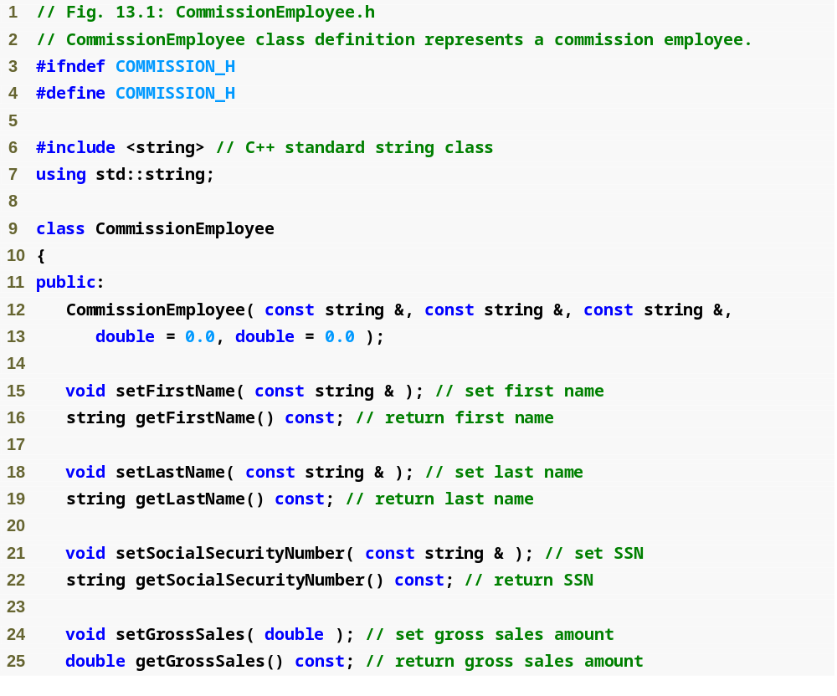
Outline
Commission
Employee.h
(1 of 2)

Slide 14
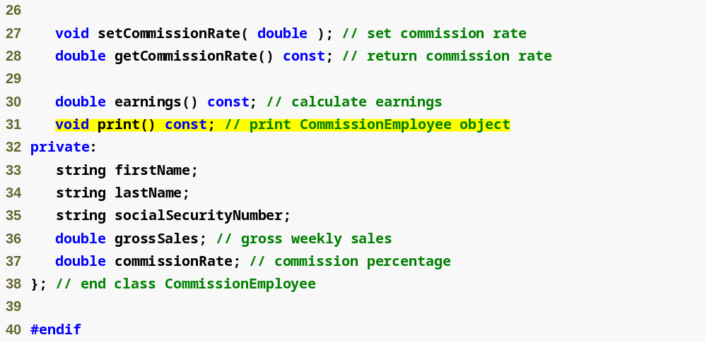
Outline
Function earnings will be redefined in derived classes to calculate the employee’s earnings
Commission
Employee.h
(2 of 2)
Function print will be redefined in derived class to print the employee’s information

Slide 15
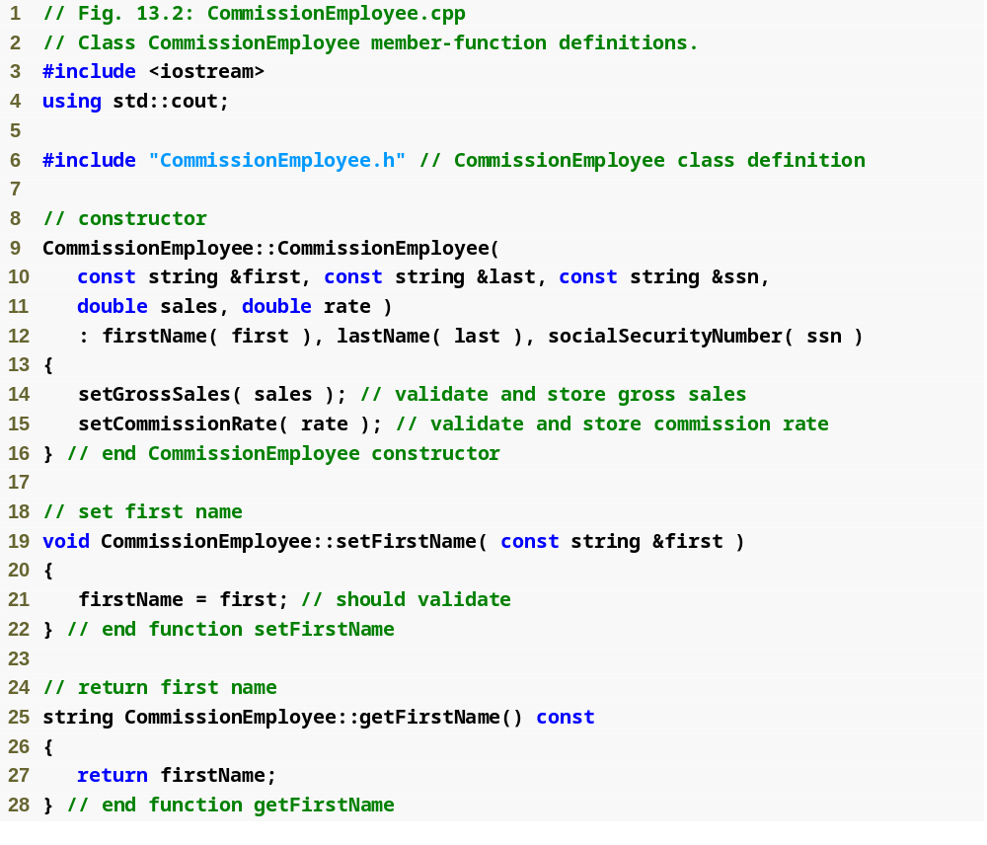
Outline
Commission
Employee.cpp
(1 of 4)

Slide 16
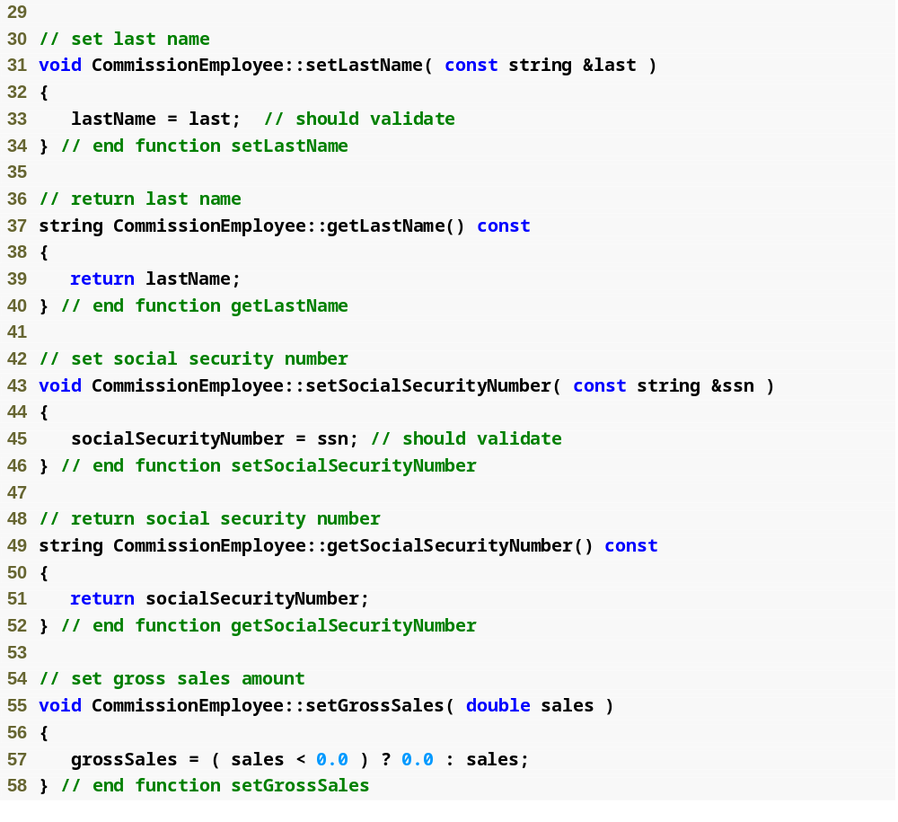
Outline
Commission
Employee.cpp
(2 of 4)

Slide 17
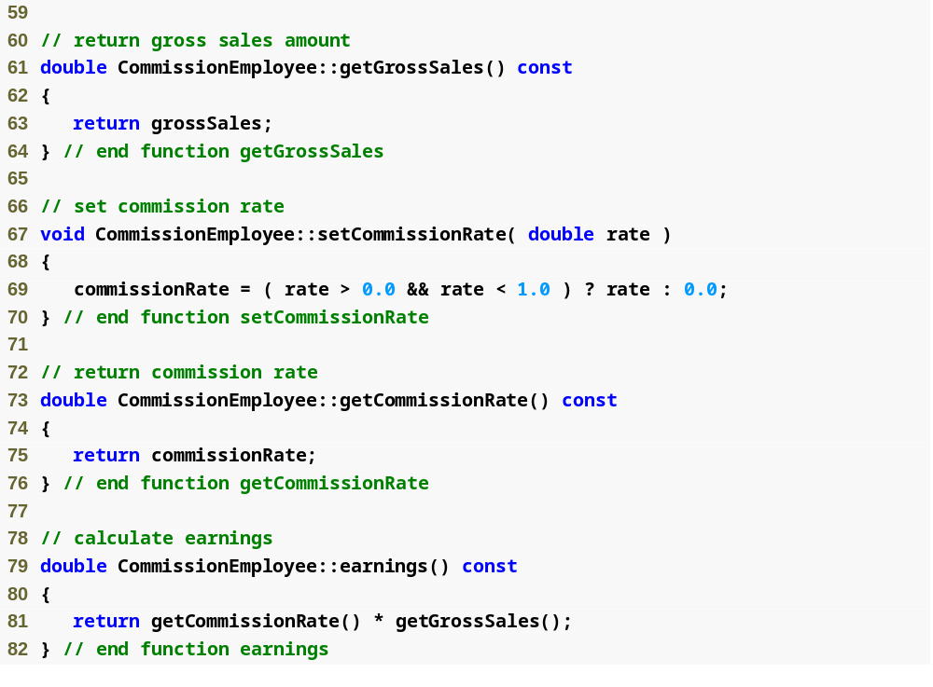
Outline
Commission
Employee.cpp
(3 of 4)
Calculate earnings based on commission rate and gross sales

Slide 18
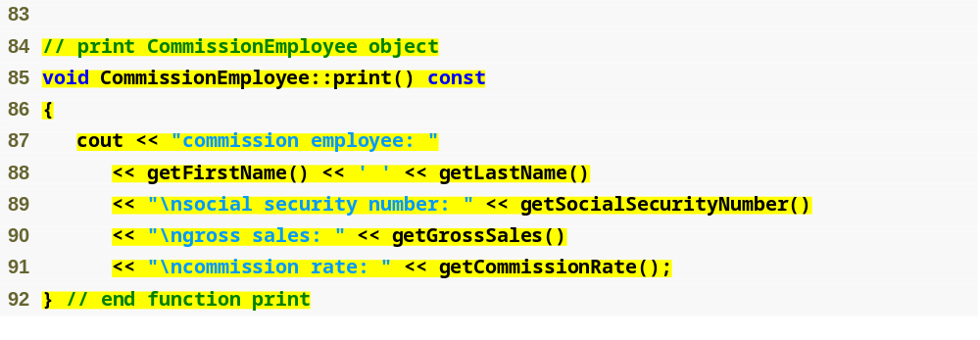
Outline
Commission
Employee.cpp
(4 of 4)
Display name, social security number, gross sales and commission rate

Slide 19
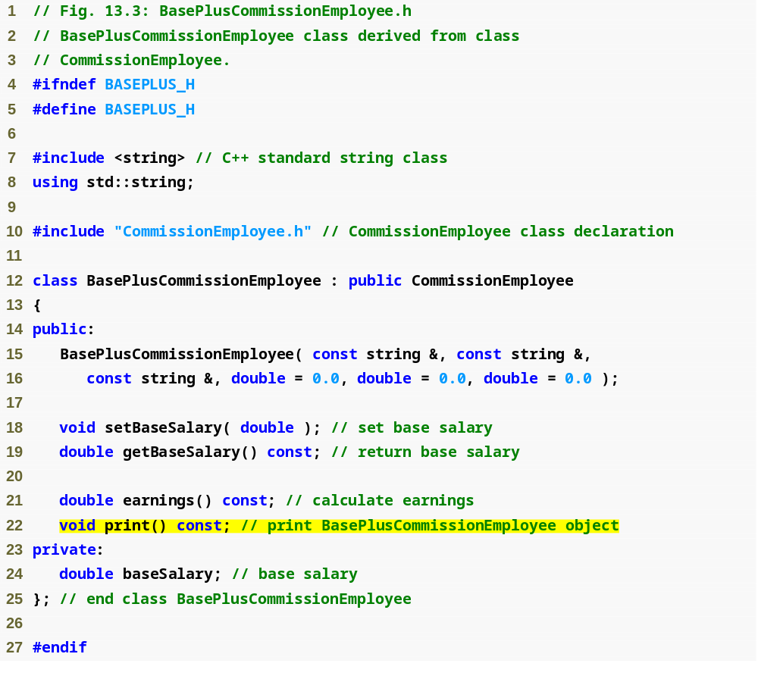
Outline
BasePlus
Commission
Employee.h
(1 of 1)
Redefine functions earnings and print

Slide 20
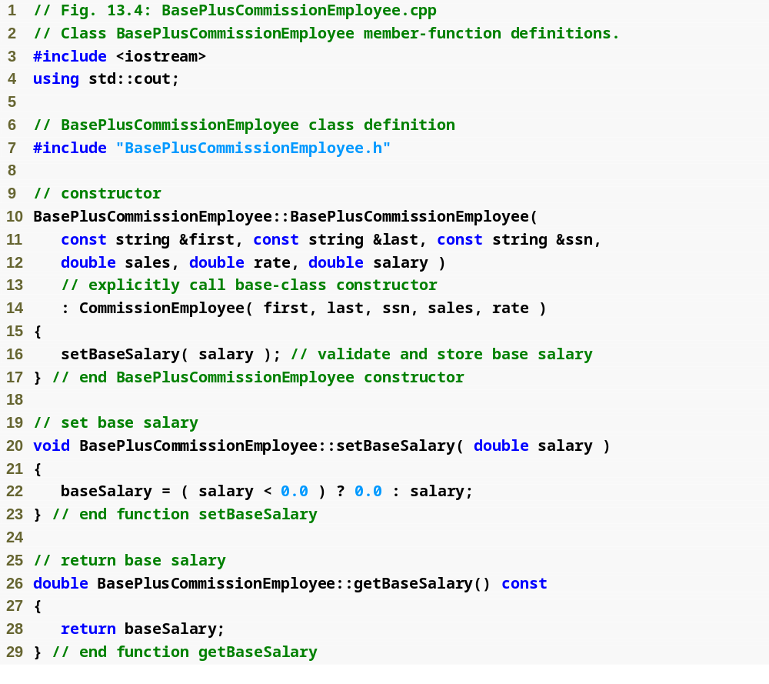
Outline
BasePlus
Commission
Employee.cpp
(1 of 2)

Slide 21
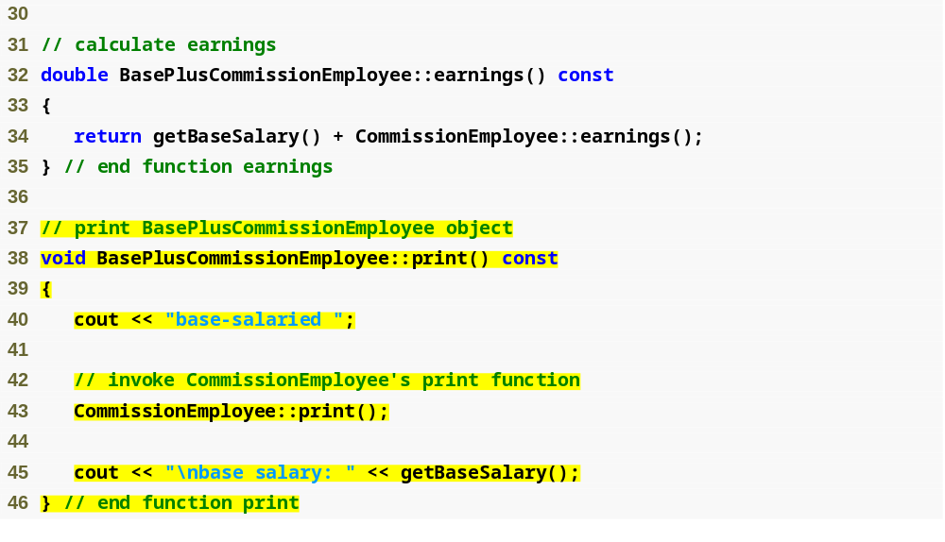
Outline
BasePlus
Commission
Employee.cpp
(2 of 2)
Redefined earnings function incorporates base salary
Redefined print function displays additional BasePlusCommissionEmployee details

Slide 22
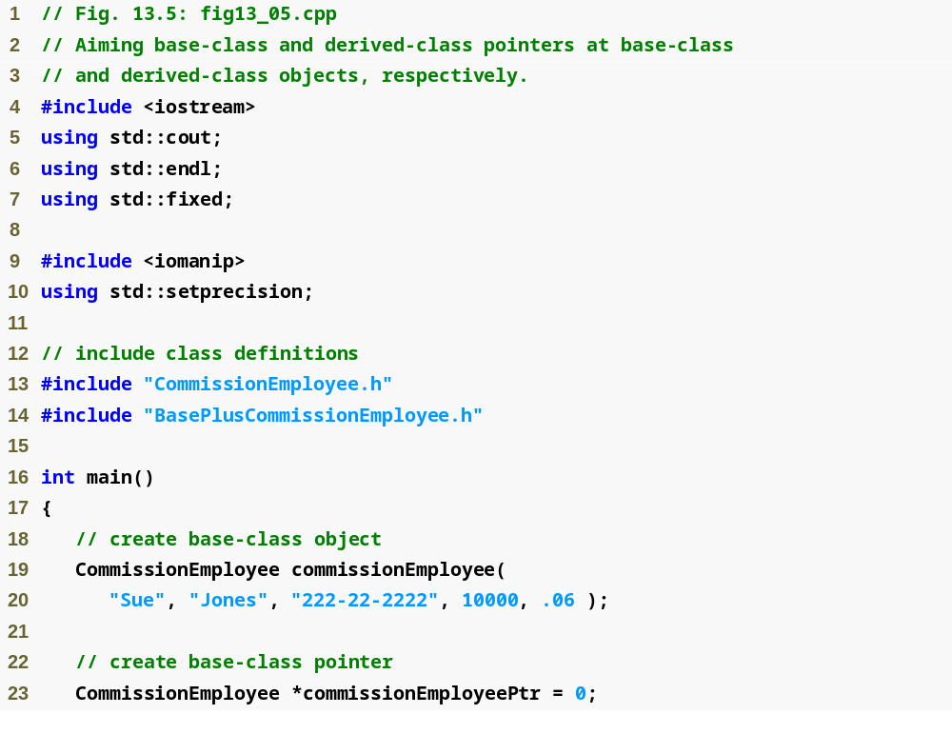
Outline
fig13_05.cpp
(1 of 5)

Slide 23
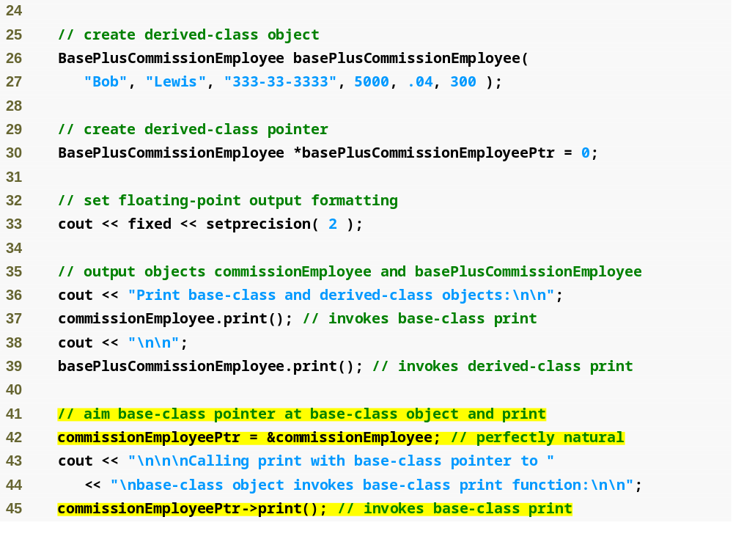
Outline
fig13_05.cpp
(2 of 5)
Aiming base-class pointer at base-class object and invoking base-class functionality

Slide 24
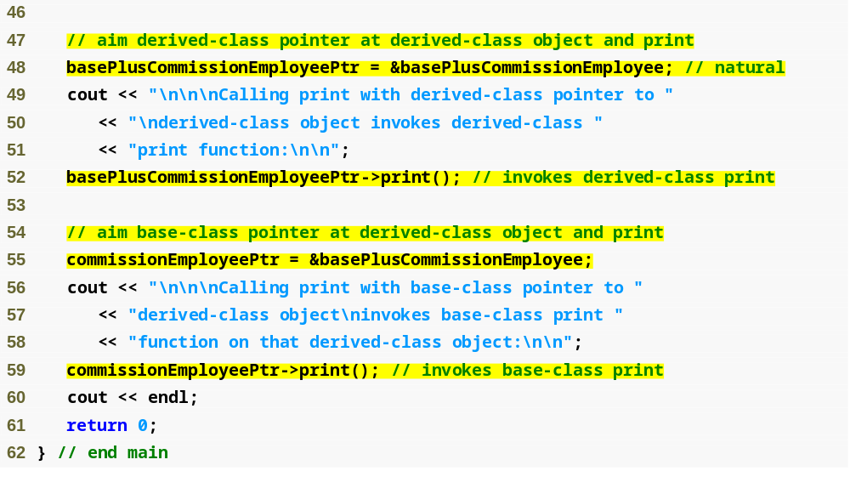
Outline
fig13_05.cpp
(3 of 5)
Aiming derived-class pointer at derived-class object and invoking derived-class functionality
Aiming base-class pointer at derived-class object and invoking base-class functionality

Slide 25
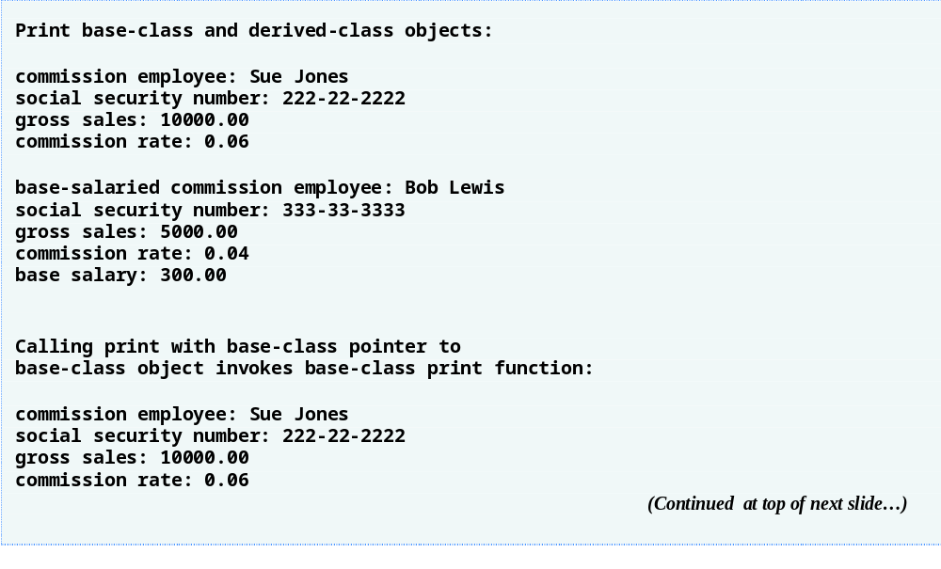
Outline
fig13_05.cpp
(4 of 5)

Slide 26
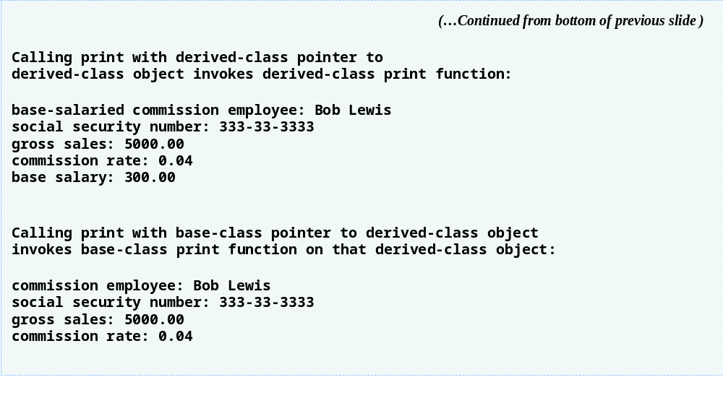
Outline
fig13_05.cpp
(5 of 5)

Slide 27
13.3.2 Aiming Derived-Class Pointers at Base-Class Objects
Aim a derived-class pointer at a base-class object
  C++ compiler generates error
    CommissionEmployee (base-class object) is not a BasePlusCommissionEmployee (derived-class object)
  If this were to be allowed, programmer could then attempt to access derived-class members which do not exist
    Could modify memory being used for other data

Slide 28
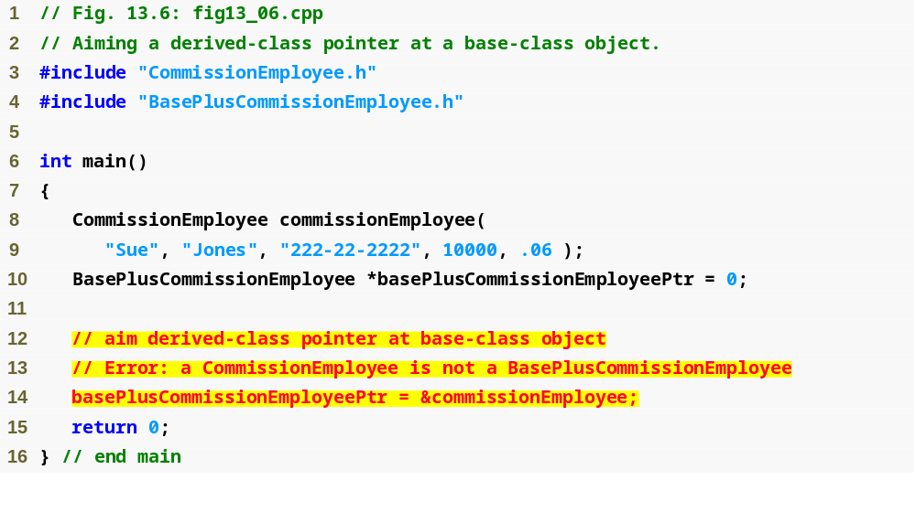
Outline
fig13_06.cpp
(1 of 2)
Cannot assign base-class object to derived-class pointer because is-a relationship does not apply

Slide 29
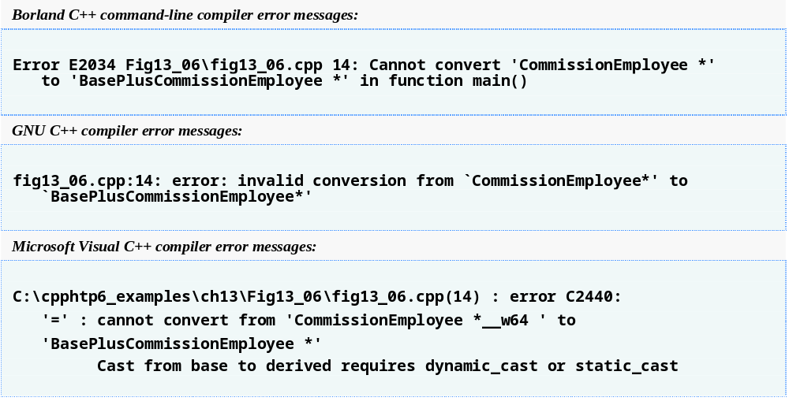
Outline
fig13_06.cpp
(2 of 2)

Slide 30
13.3.3 Derived-Class Member-Function Calls via Base-Class Pointers
Aiming base-class pointer at derived-class object
  Calling functions that exist in base class causes base-class functionality to be invoked
  Calling functions that do not exist in base class (may exist in derived class) will result in error
    Derived-class members cannot be accessed from base-class pointers
    However, this can be accomplished using downcasting (Section 13.8)

Slide 31
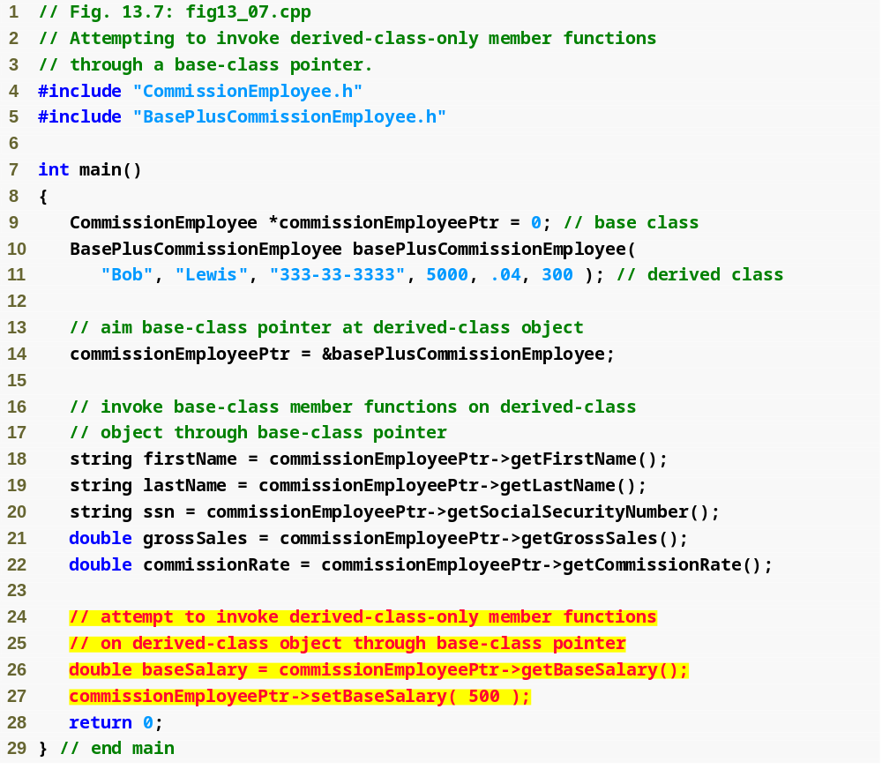
Outline
fig13_07.cpp
(1 of 2)
Cannot invoke derived-class-only members from base-class pointer

Slide 32
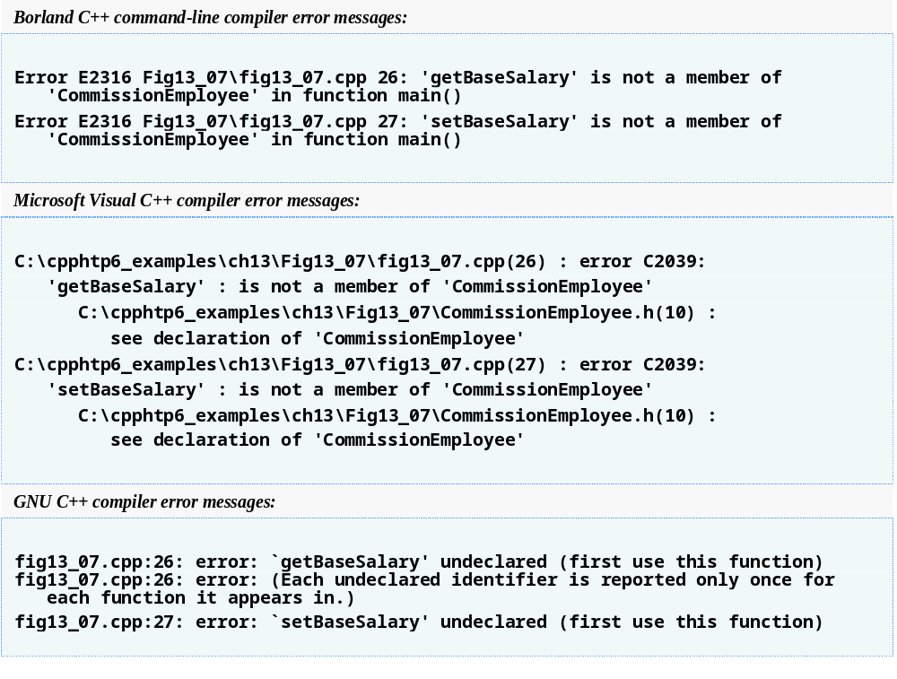
Outline
fig13_07.cpp
(2 of 2)

Slide 33
Software Engineering Observation 13.3
If the address of a derived-class object has been assigned to a pointer of one of its direct or indirect base classes, it is acceptable to cast that base-class pointer back to a pointer of the derived-class type. In fact, this must be done to send that derived-class object messages that do not appear in the base class.

Slide 34
13.3.4 Virtual Functions
Which class’s function to invoke
  Normally
    Handle determines which class’s functionality to invoke
  With virtual functions
    Type of the object being pointed to, not type of the handle, determines which version of a virtual function to invoke
    Allows program to dynamically (at runtime rather than compile time) determine which function to use
      Called dynamic binding or late binding

Slide 35
13.3.4 Virtual Functions (Cont.)
virtual functions
  Declared by preceding the function’s prototype with the keyword virtual in base class
  Derived classes override function as appropriate
  Once declared virtual, a function remains virtual all the way down the hierarchy
  Static binding
    When calling a virtual function using specific object with dot operator, function invocation resolved at compile time
  Dynamic binding
    Dynamic binding occurs only off pointer and reference handles

Slide 36
Software Engineering Observation 13.4
Once a function is declared virtual, it remains virtual all the way down the inheritance hierarchy from that point, even if that function is not explicitly declared virtual when a class overrides it.

Slide 37
Good Programming Practice 13.1
Even though certain functions are implicitly virtual because of a declaration made higher in the class hierarchy, explicitly declare these functions virtual at every level of the hierarchy to promote program clarity.

Slide 38
Error-Prevention Tip 13.1
When a programmer browses a class hierarchy to locate a class to reuse, it is possible that a function in that class will exhibit virtual function behavior even though it is not explicitly declared virtual. This happens when the class inherits a virtual function from its base class, and it can lead to subtle logic errors. Such errors can be avoided by explicitly declaring all virtual functions virtual throughout the inheritance hierarchy.

Slide 39
Software Engineering Observation 13.5
When a derived class chooses not to override a virtual function from its base class, the derived class simply inherits its base class’s virtual function implementation.

Slide 40
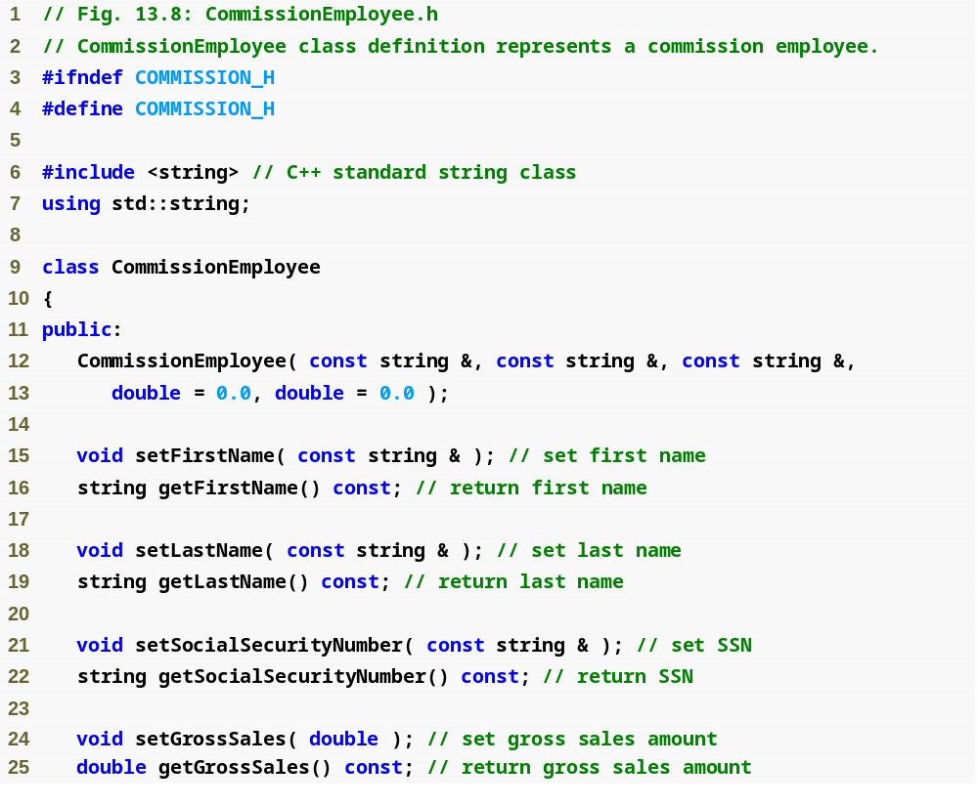
Outline
Commission
Employee.h
(1 of 2)

Slide 41
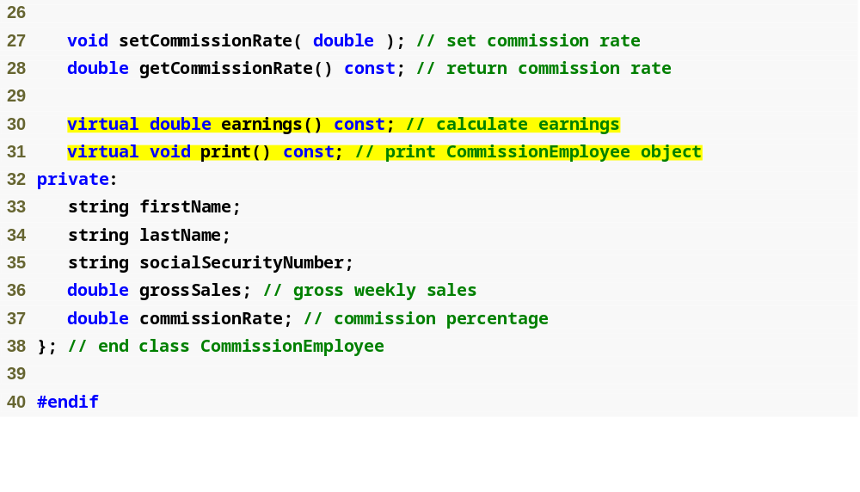
Outline
Commission
Employee.h
(2 of 2)
Declaring earnings and print as virtual allows them to be overridden, not redefined

Slide 42
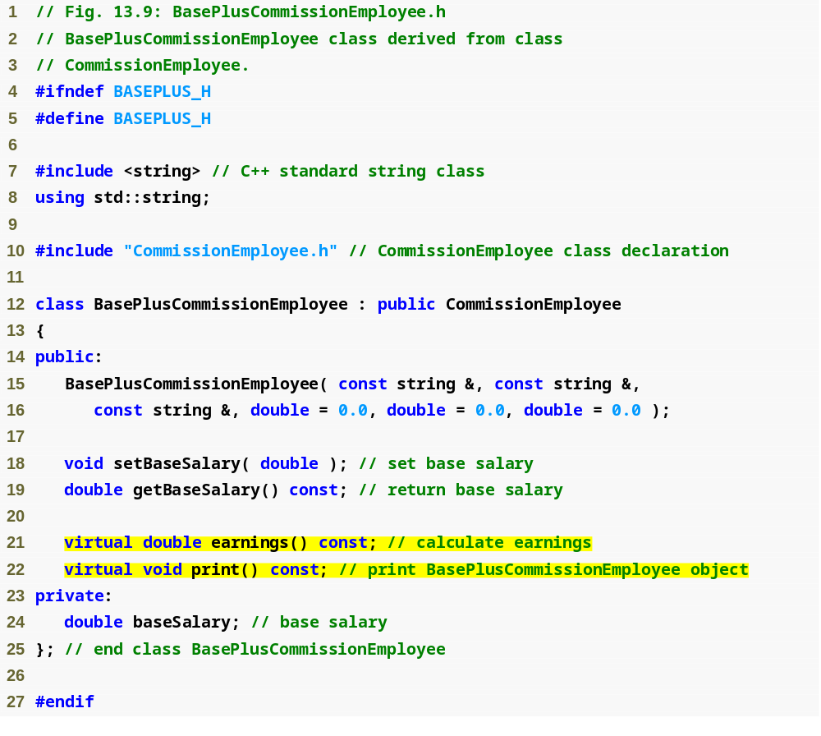
Outline
BasePlus
Commission
Employee.h
(1 of 1)
Functions earnings and print are already virtual – good practice to declare virtual even when overriding function

Slide 43
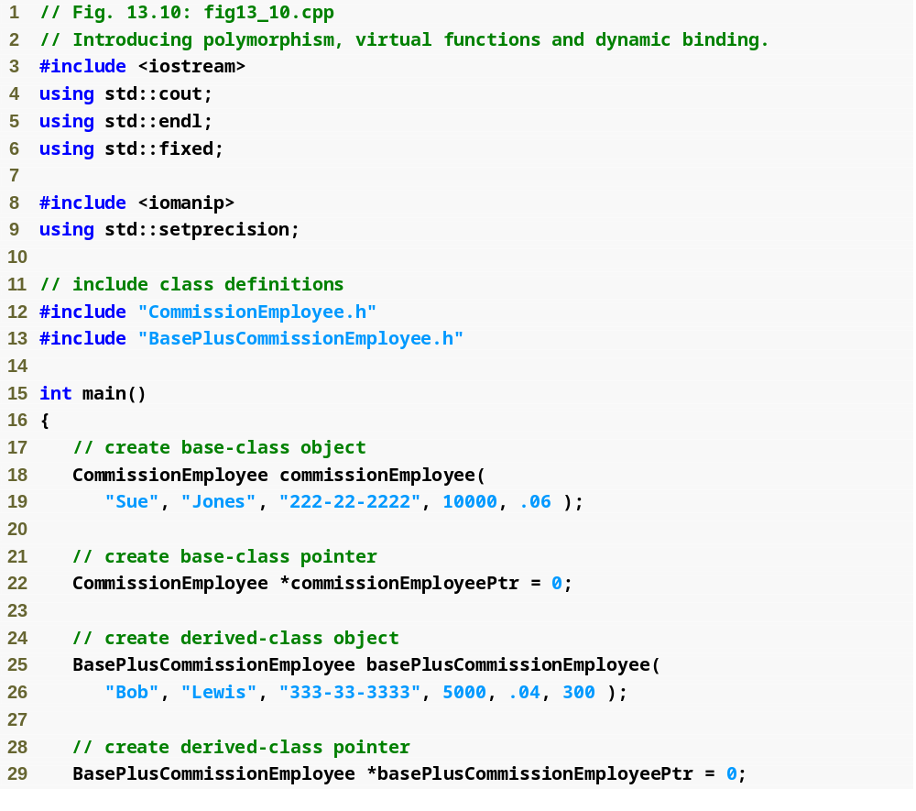
Outline
fig13_10.cpp
(1 of 5)

Slide 44
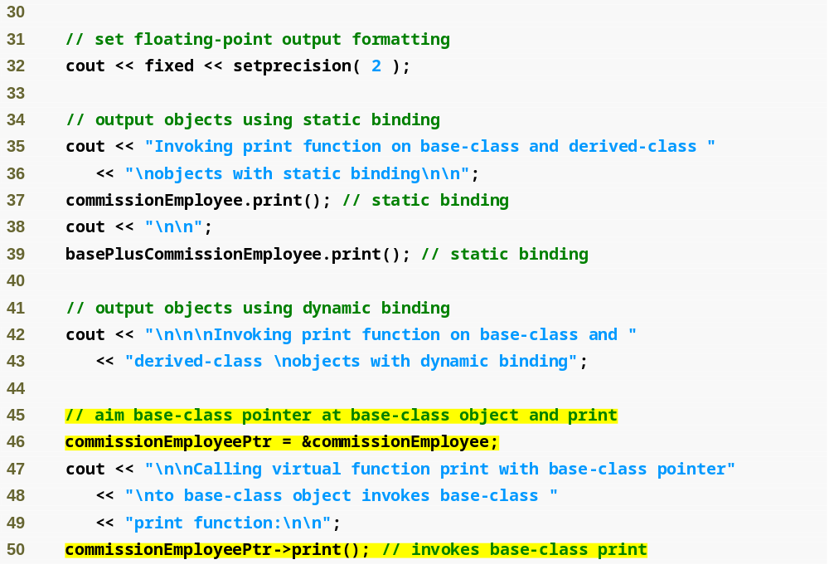
Outline
fig13_10.cpp
(2 of 5)
Aiming base-class pointer at base-class object and invoking base-class functionality

Slide 45
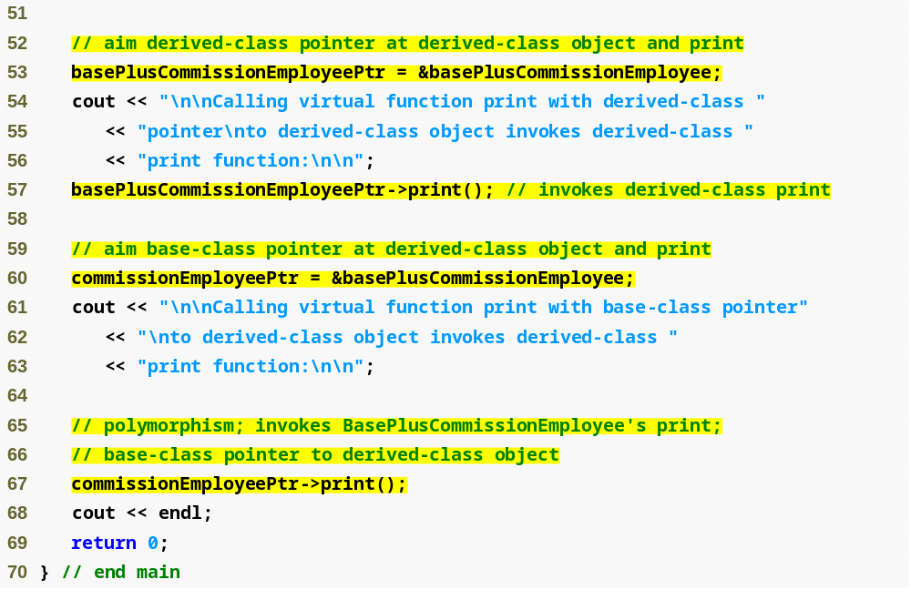
Outline
fig13_10.cpp
(3 of 5)
Aiming derived-class pointer at derived-class object and invoking derived-class functionality
Aiming base-class pointer at derived-class object and invoking derived-class functionality via polymorphism and virtual functions

Slide 46
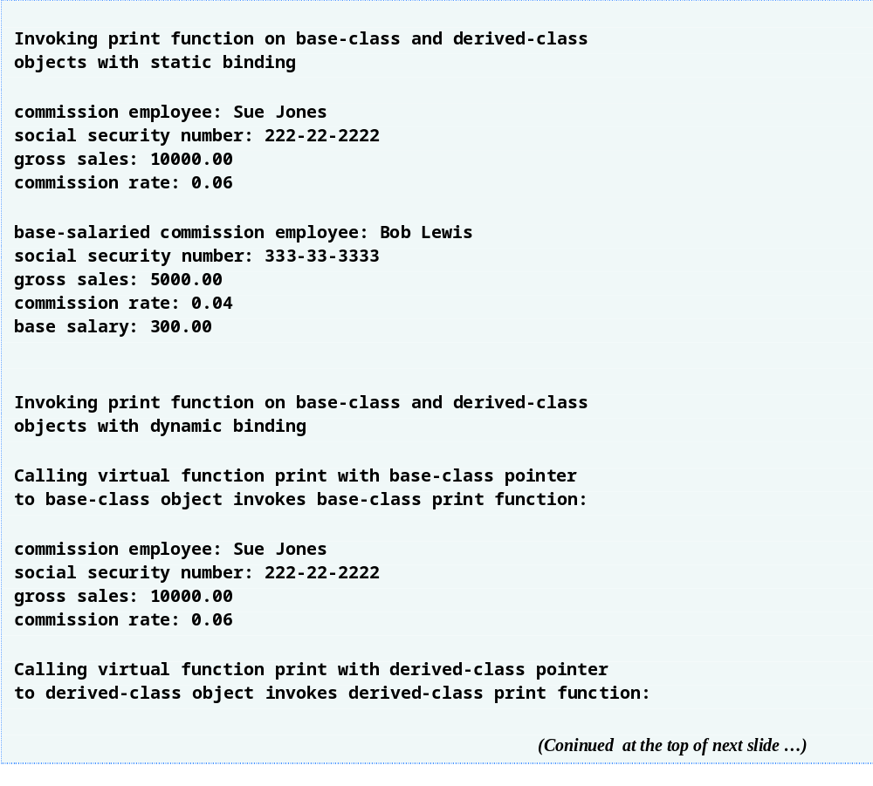
Outline
fig13_10.cpp
(4 of 5)

Slide 47
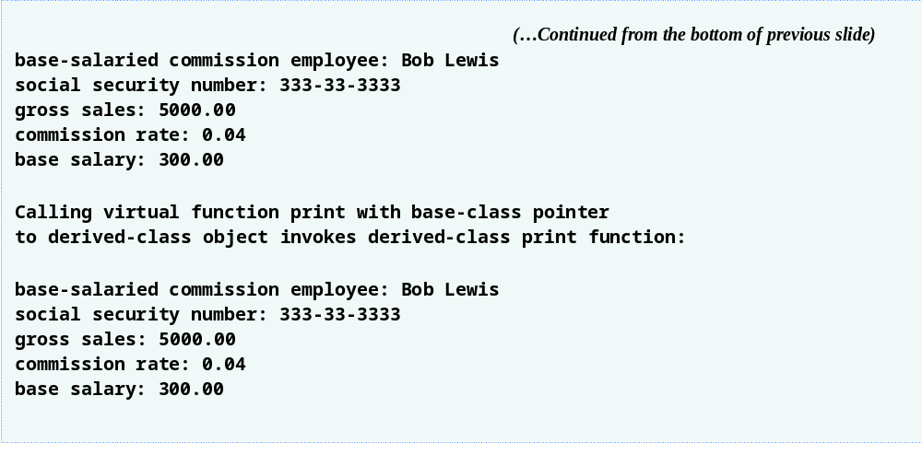
Outline
fig13_10.cpp
(5 of 5)

Slide 48
13.3.5 Summary of the Allowed Assignments Between Base-Class and Derived-Class Objects and Pointers
Four ways to aim base-class and derived-class pointers at base-class and derived-class objects
  Aiming a base-class pointer at a base-class object
    Is straightforward
  Aiming a derived-class pointer at a derived-class object
    Is straightforward
  Aiming a base-class pointer at a derived-class object
    Is safe, but can be used to invoke only member functions that base-class declares (unless downcasting is used)
    Can achieve polymorphism with virtual functions
  Aiming a derived-class pointer at a base-class object
    Generates a compilation error

Slide 49
Common Programming Error 13.1
After aiming a base-class pointer at a derived-class object, attempting to reference derived-class-only members with the base-class pointer is a compilation error.

Slide 50
Common Programming Error 13.2
Treating a base-class object as a derived-class object can cause errors.

Slide 51
13.4 Type Fields and switch Statements
switch statement could be used to determine the type of an object at runtime
  Include a type field as a data member in the base class
  Enables programmer to invoke appropriate action for a particular object
  Causes problems
    A type test may be forgotten
    May forget to add new types

Slide 52
Software Engineering Observation 13.6
Polymorphic programming can eliminate the need for unnecessary switch logic. By using the C++ polymorphism mechanism to perform the equivalent logic, programmers can avoid the kinds of errors typically associated with switch logic.

Slide 53
Software Engineering Observation 13.7
An interesting consequence of using polymorphism is that programs take on a simplified appearance. They contain less branching logic and more simple, sequential code. This simplification facilitates testing, debugging and program maintenance.

Slide 54
13.5 Abstract Classes and Pure virtual Functions
Abstract classes
  Classes from which the programmer never intends to instantiate any objects
    Incomplete—derived classes must define the “missing pieces”
    Too generic to define real objects
  Normally used as base classes, called abstract base classes
    Provides an appropriate base class from which other classes can inherit
    Classes used to instantiate objects are called concrete classes
      Must provide implementation for every member function they define

Slide 55
13.5 Abstract Classes and Pure virtual Functions (Cont.)
Pure virtual function
  A class is made abstract by declaring one or more of its virtual functions to be “pure”
    Placing “= 0” in its declaration
      Example
        virtual void draw() const = 0;
      “= 0” is known as a pure specifier
  Do not provide implementations
    Every concrete derived class must override all base-class pure virtual functions with concrete implementations
      If not overridden, derived-class will also be abstract
  Used when it does not make sense for base class to have an implementation of a function, but the programmer wants all concrete derived classes to implement the function

Slide 56
Software Engineering Observation 13.8
An abstract class defines a common public interface for the various classes in a class hierarchy. An abstract class contains one or more pure virtual functions that concrete derived classes must override.

Slide 57
Common Programming Error 13.3
Attempting to instantiate an object of an abstract class causes a compilation error.

Slide 58
Common Programming Error 13.4
Failure to override a pure virtual function in a derived class, then attempting to instantiate objects of that class, is a compilation error.

Slide 59
Software Engineering Observation 13.9
An abstract class has at least one pure virtual function. An abstract class also can have data members and concrete functions (including constructors and destructors), which are subject to the normal rules of inheritance by derived classes.

Slide 60
13.5 Abstract Classes and Pure virtual Functions (Cont.)
We can use the abstract base class to declare pointers and references
  Can refer to objects of any concrete class derived from the abstract class
  Programs typically use such pointers and references to manipulate derived-class objects polymorphically
Polymorphism is particularly effective for implementing layered software systems
  Reading or writing data from and to devices
Iterator class
  Can traverse all the objects in a container

Slide 61
13.6 Case Study: Payroll System Using Polymorphism
Enhanced CommissionEmployee-BasePlusCommissionEmployee hierarchy using an abstract base class
  Abstract class Employee represents the general concept of an employee
    Declares the “interface” to the hierarchy
    Each employee has a first name, last name and social security number
  Earnings calculated differently and objects printed differently for each derived classe

Slide 62
Software Engineering Observation 13.10
A derived class can inherit interface or implementation from a base class. Hierarchies designed for implementation inheritance tend to have their functionality high in the hierarchy—each new derived class inherits one or more member functions that were defined in a base class, and the derived class uses the base-class definitions. Hierarchies designed for interface inheritance tend to have their functionality lower in the hierarchy—a base class specifies one or more functions that should be defined for each class in the hierarchy (i.e., they have the same prototype), but the individual derived classes provide their own implementations of the function(s).

Slide 63
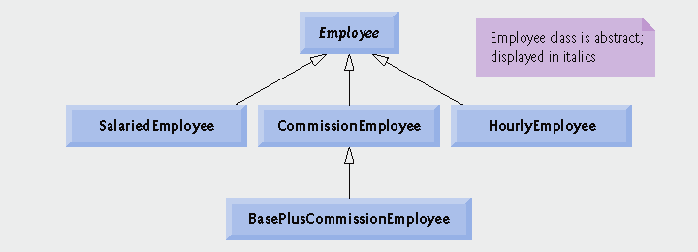
Fig.13.11 | Employee hierarchy UML class diagram.

Slide 64
13.6.1 Creating Abstract Base Class Employee
Class Employee
  Provides various get and set functions
  Provides functions earnings and print
    Function earnings depends on type of employee, so declared pure virtual
      Not enough information in class Employee for a default implementation
    Function print is virtual, but not pure virtual
      Default implementation provided in Employee
  Example maintains a vector of Employee pointers
    Polymorphically invokes proper earnings and print functions

Slide 65
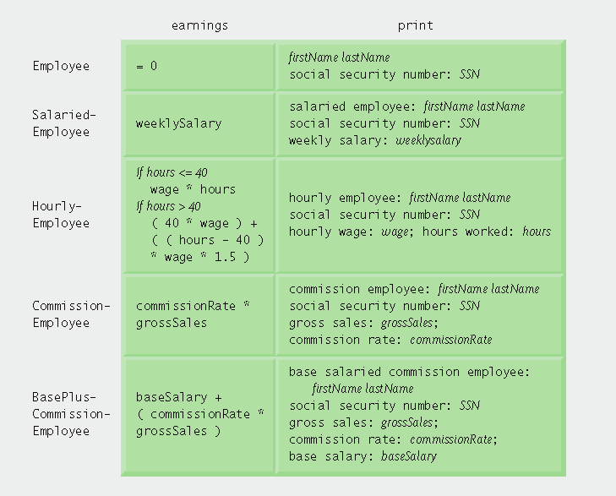
Fig.13.12 | Polymorphic interface for the Employee hierarchy classes.

Slide 66
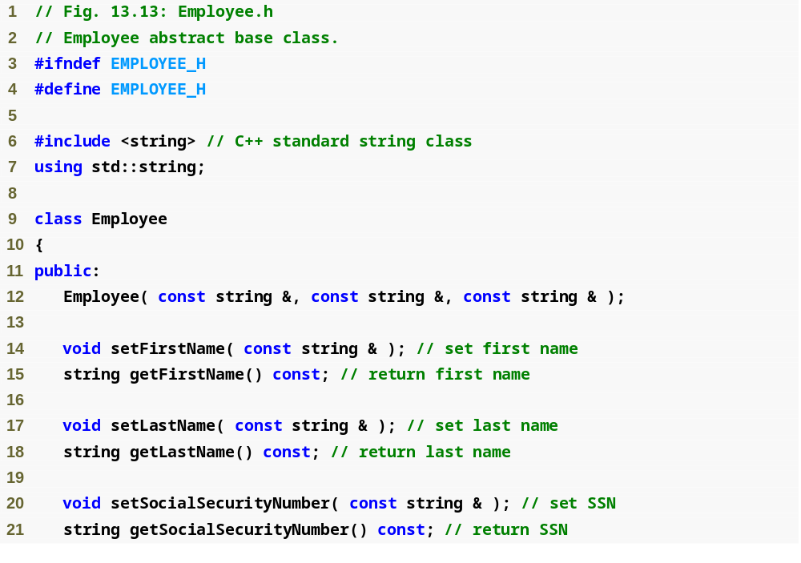
Outline
Employee.h
(1 of 2)

Slide 67
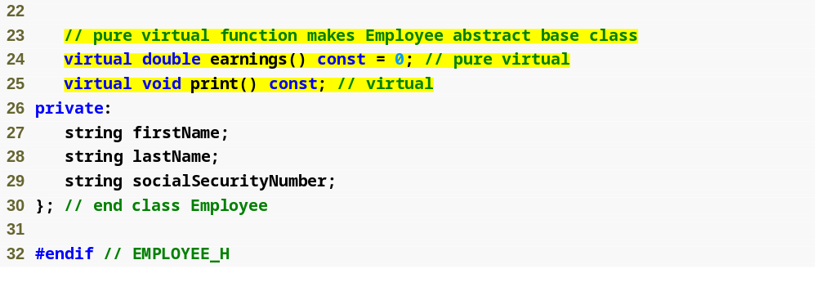
Outline
Function earnings is pure virtual, not enough data to provide a default, concrete implementation
Employee.h
(2 of 2)
Function print is virtual, default implementation provided but derived-classes may override

Slide 68
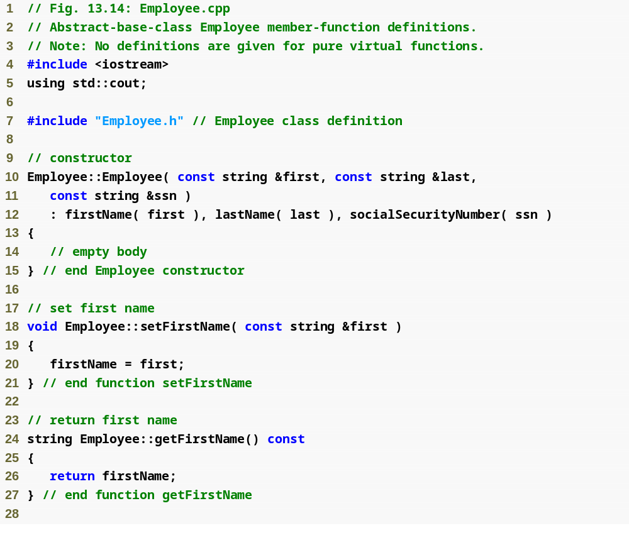
Outline
Employee.cpp
(1 of 2)

Slide 69
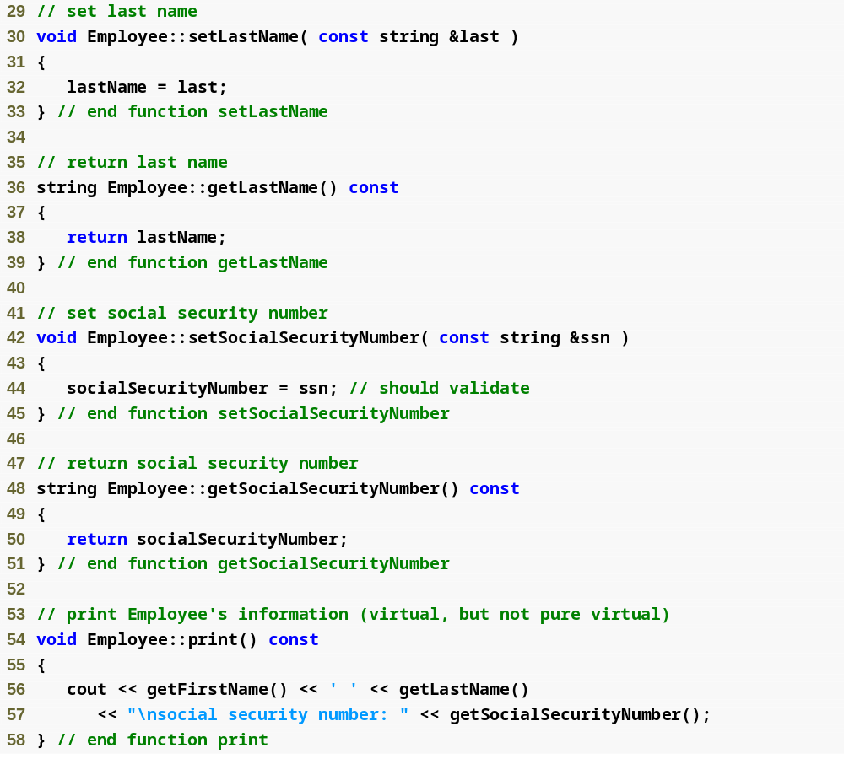
Outline
Employee.cpp
(2 of 2)

Slide 70
13.6.2 Creating Concrete Derived Class SalariedEmployee
SalariedEmployee inherits from Employee
  Includes a weekly salary
    Overridden earnings function incorporates weekly salary
    Overridden print function incorporates weekly salary
  Is a concrete class (implements all pure virtual functions in abstract base class)

Slide 71
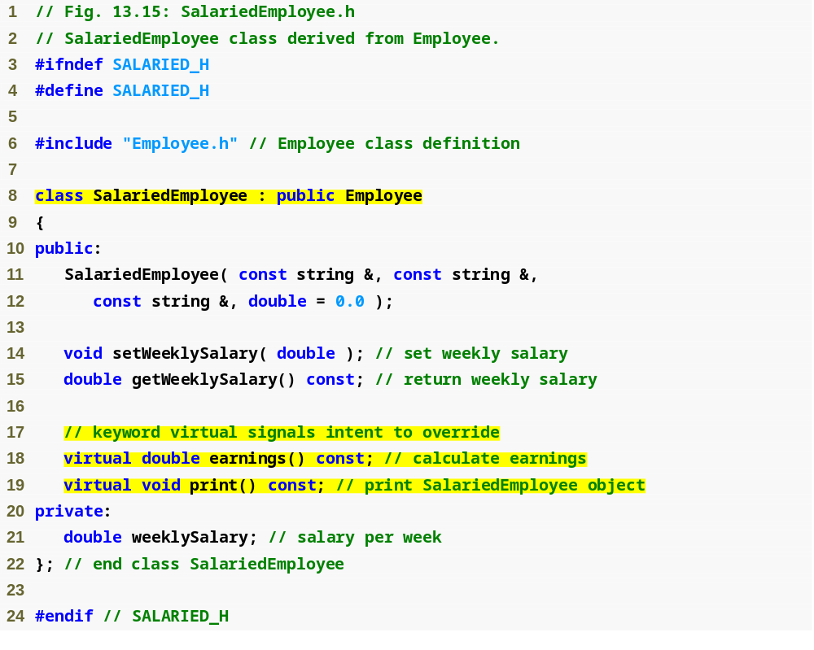
Outline
Salaried
Employee.h
(1 of 1)
SalariedEmployee inherits from Employee, must override earnings to be concrete
Functions will be overridden (or defined for the first time)

Slide 72
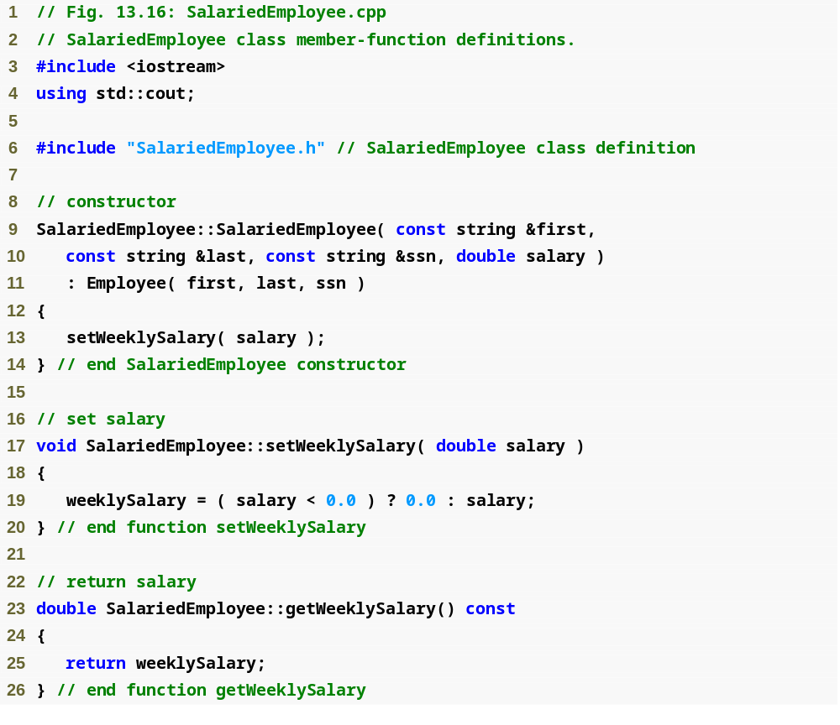
Outline
Salaried
Employee.cpp
(1 of 2)
Maintain new data member weeklySalary

Slide 73
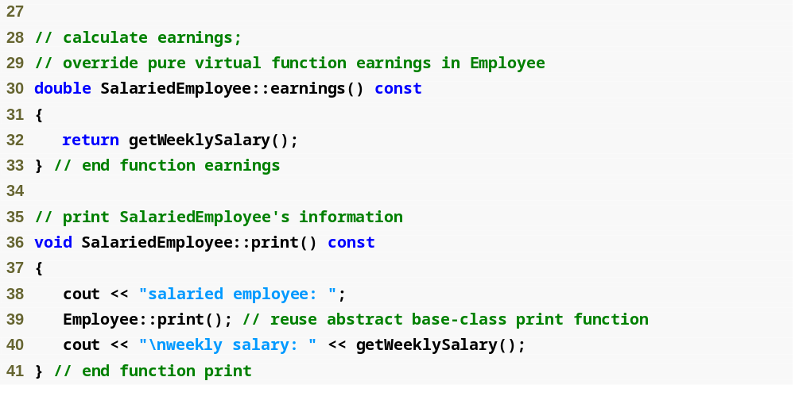
Outline
Salaried
Employee.cpp
(1 of 2)
Overridden earnings and print functions incorporate weekly salary

Slide 74
13.6.3 Creating Concrete Derived Class HourlyEmployee
HourlyEmployee inherits from Employee
  Includes a wage and hours worked
    Overridden earnings function incorporates the employee’s wages multiplied by hours (taking time-and-a-half pay into account)
    Overridden print function incorporates wage and hours worked
  Is a concrete class (implements all pure virtual functions in abstract base class)

Slide 75
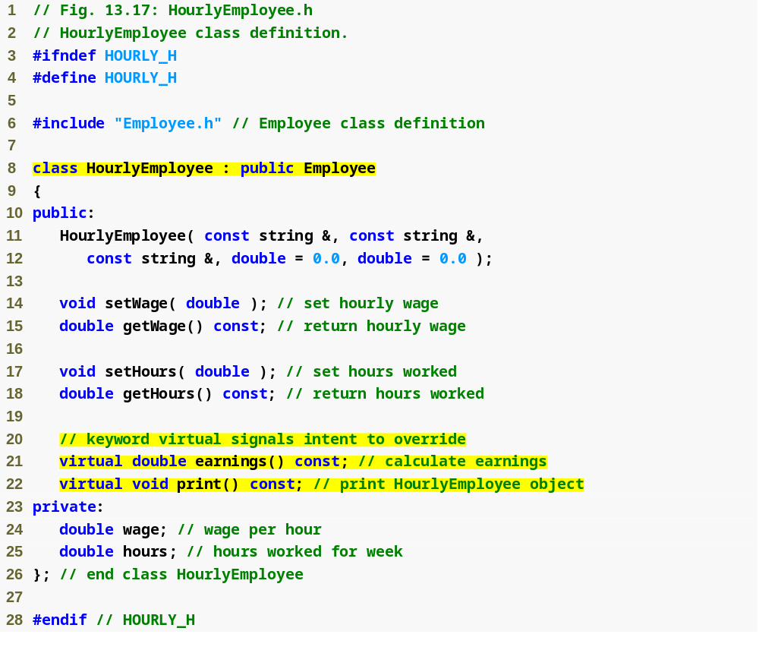
Outline
Hourly
Employee.h
(1 of 1)
HourlyEmployee inherits from Employee, must override earnings to be concrete
Functions will be overridden (or defined for first time)

Slide 76
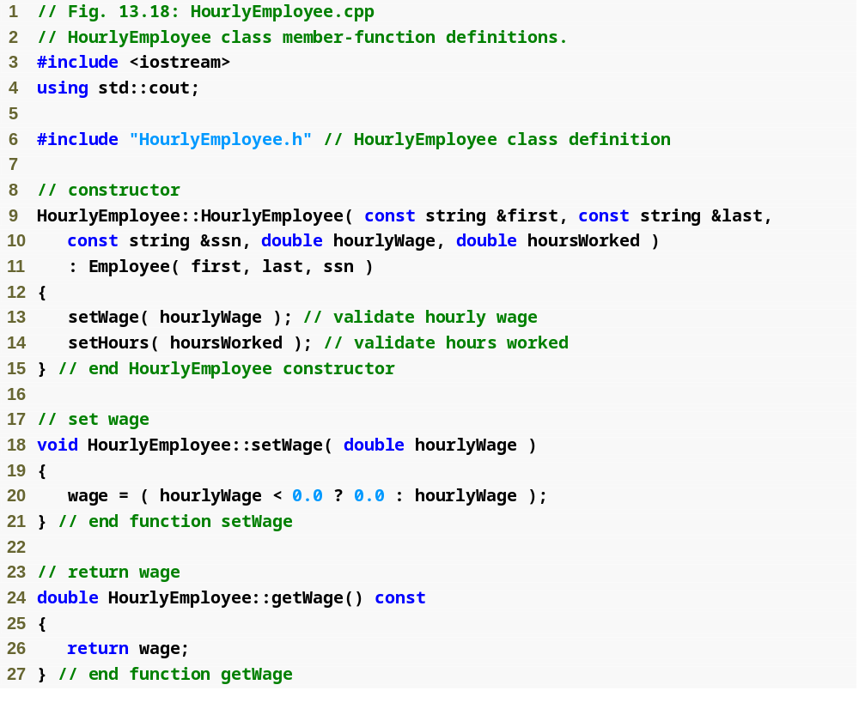
Outline
Hourly
Employee.cpp
(1 of 2)
Maintain new data member, hourlyWage

Slide 77
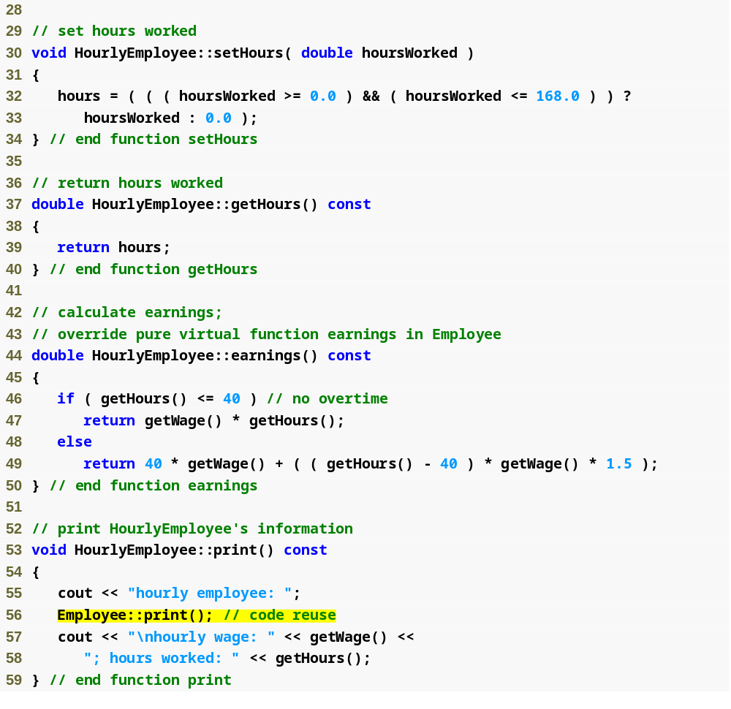
Outline
Maintain new data member, hoursWorked
Hourly
Employee.cpp
(2 of 2)
Overridden earnings and print functions incorporate wage and hours

Slide 78
13.6.4 Creating Concrete Derived Class CommissionEmployee
CommissionEmployee inherits from Employee
  Includes gross sales and commission rate
    Overridden earnings function incorporates gross sales and commission rate
    Overridden print function incorporates gross sales and commission rate
  Concrete class (implements all pure virtual functions in abstract base class)

Slide 79
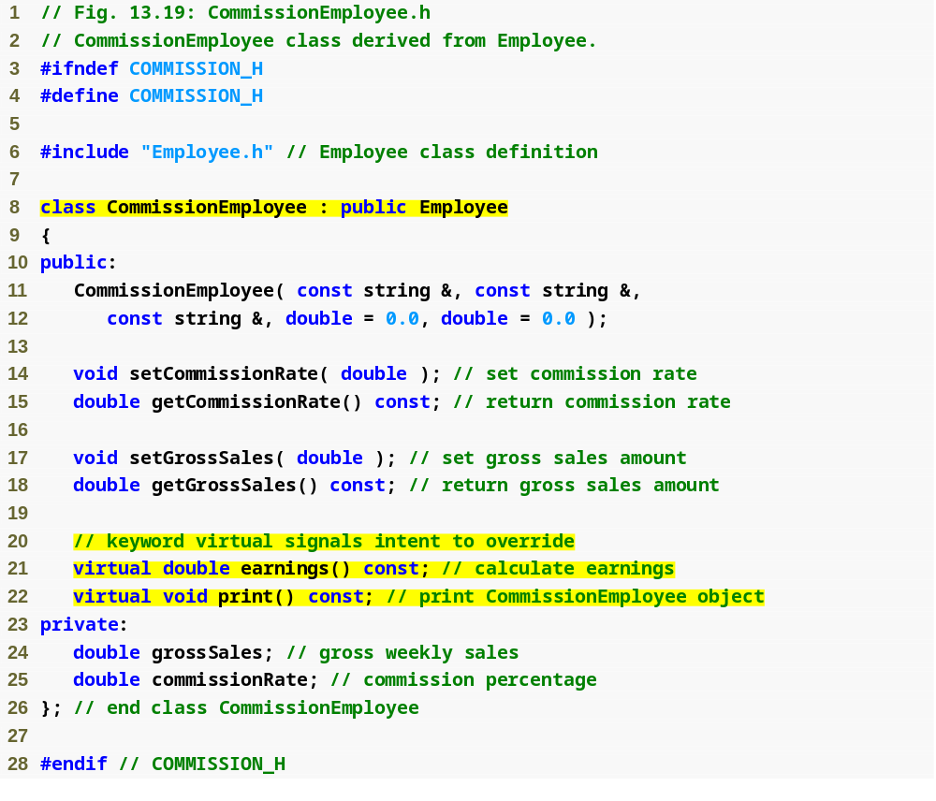
Outline
Commission
Employee.h
(1 of 1)
CommissionEmployee inherits from Employee, must override earnings to be concrete
Functions will be overridden (or defined for first time)

Slide 80
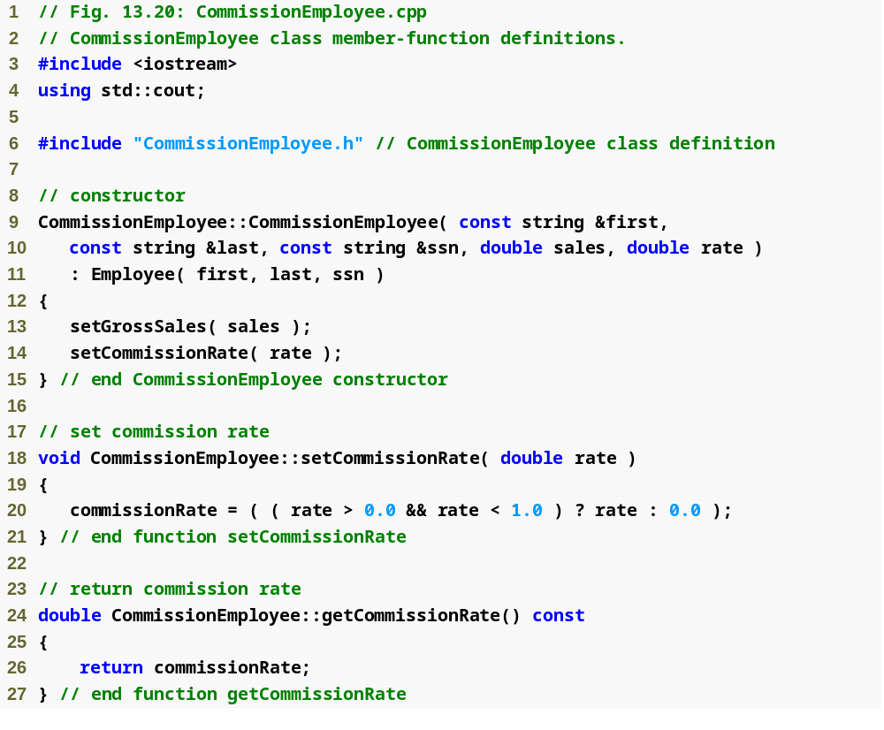
Outline
Commission
Employee.cpp
(1 of 2)
Maintain new data member, commissionRate

Slide 81
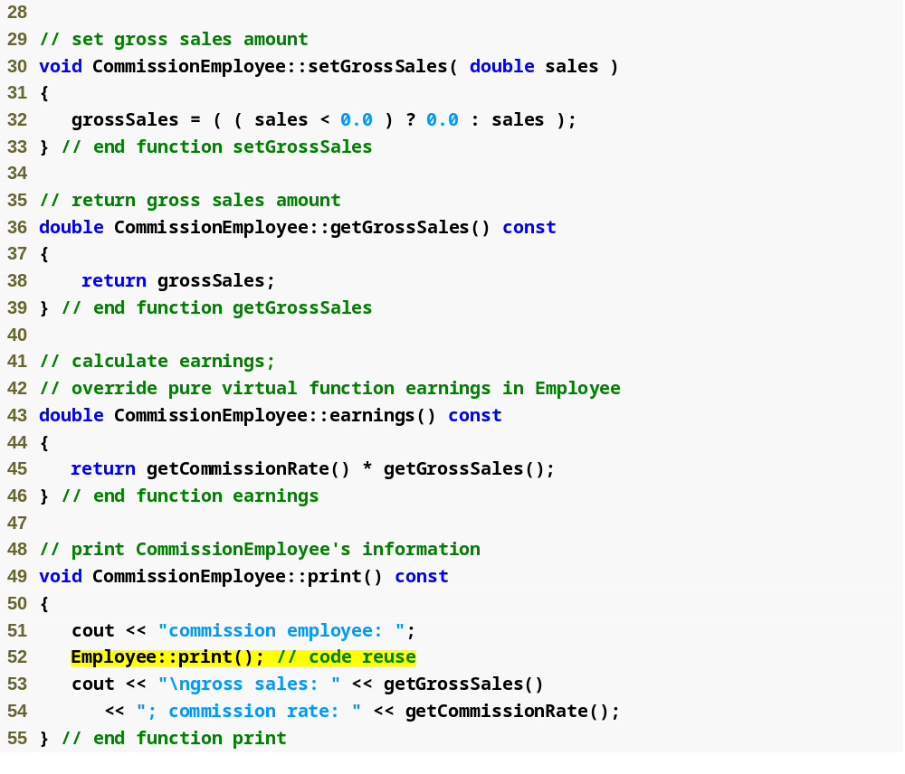
Outline
Maintain new data member, grossSales
Commission
Employee.cpp
(2 of 2)
Overridden earnings and print functions incorporate commission rate and gross sales

Slide 82
13.6.5 Creating Indirect Concrete Derived Class BasePlusCommissionEmployee
BasePlusCommissionEmployee inherits from CommissionEmployee
  Includes base salary
    Overridden earnings function that incorporates base salary
    Overridden print function that incorporates base salary
  Concrete class, because derived class is concrete
    Not necessary to override earnings to make it concrete, can inherit implementation from CommissionEmployee
      Although we do override earnings to incorporate base salary

Slide 83
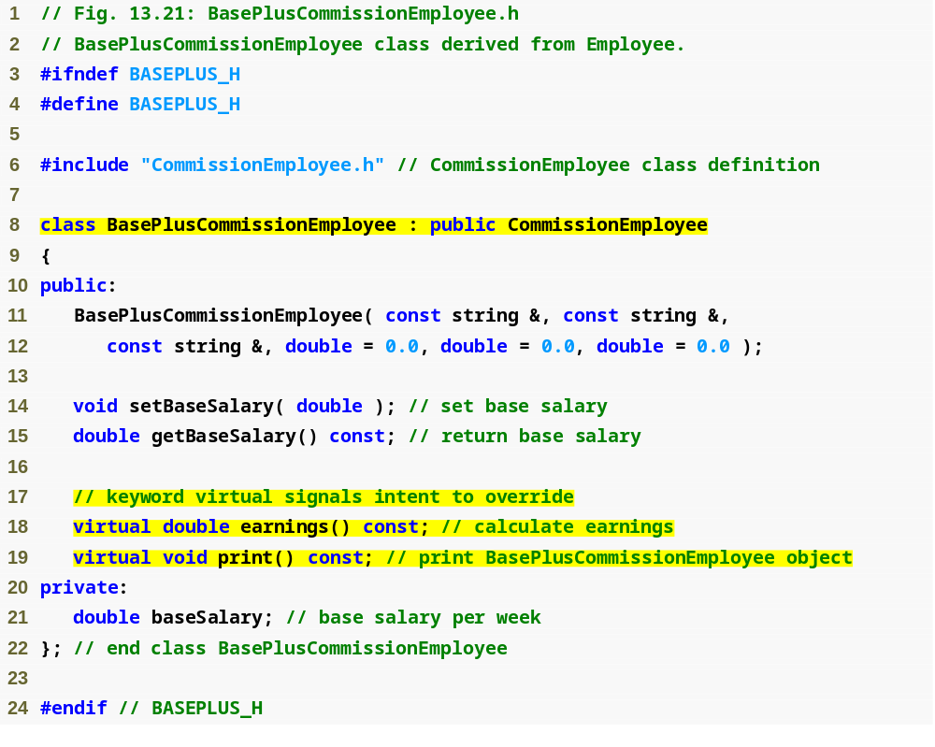
Outline
BasePlus
Commission
Employee.h
(1 of 1)
BasePlusCommissionEmployee inherits from CommissionEmployee, already concrete
Functions will be overridden

Slide 84
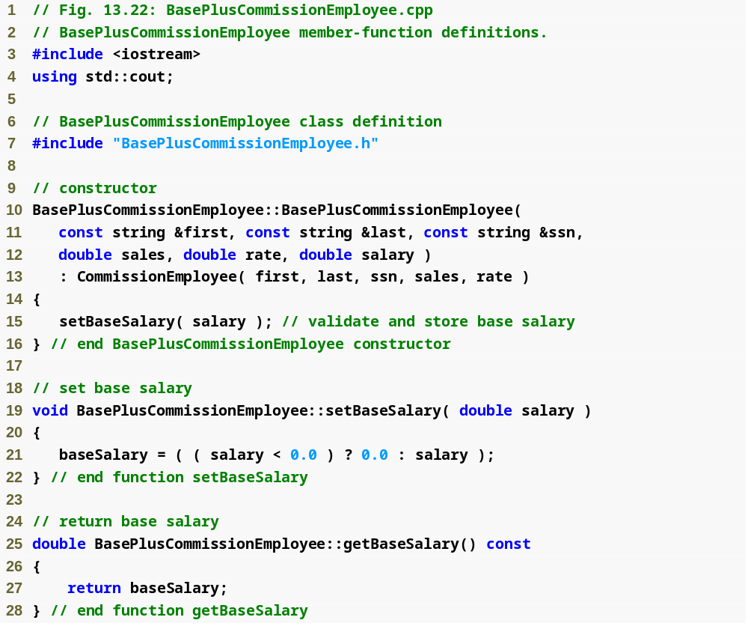
Outline
BasePlus
Commission
Employee.cpp
(1 of 2)
Maintain new data member, baseSalary

Slide 85
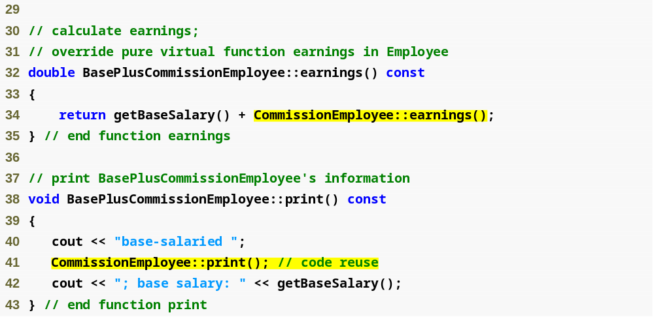
Outline
BasePlus
Commission
Employee.cpp
(1 of 2)
Overridden earnings and print functions incorporate base salary

Slide 86
13.6.6 Demonstrating Polymorphic Processing
Create objects of types SalariedEmployee, HourlyEmployee, CommissionEmployee and BasePlusCommissionEmployee
  Demonstrate manipulating objects with static binding
    Using name handles rather than pointers or references
    Compiler can identify each object’s type to determine which print and earnings functions to call
  Demonstrate manipulating objects polymorphically
    Uses a vector of Employee pointers
    Invoke virtual functions using pointers and references

Slide 87
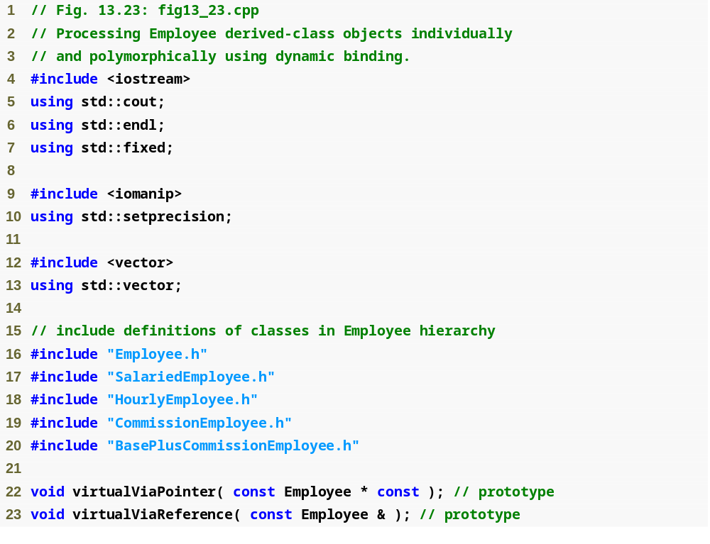
Outline
fig13_23.cpp
(1 of 7)

Slide 88
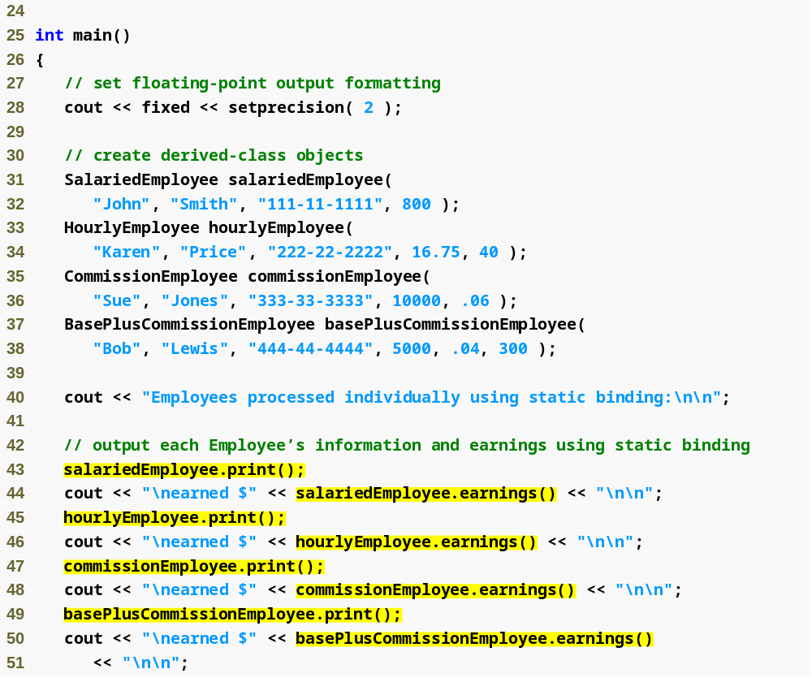
Outline
fig13_23.cpp
(2 of 7)
Using objects (rather than pointers or references) to demonstrate static binding

Slide 89
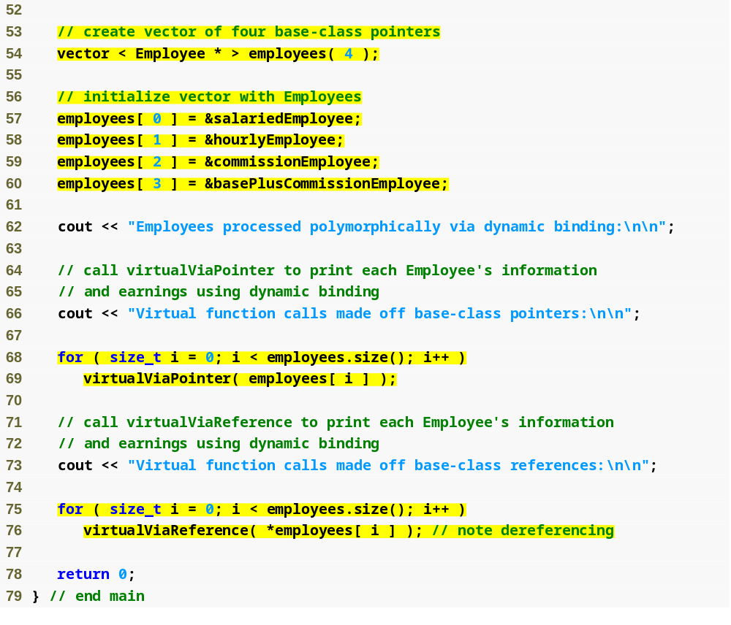
Outline
vector of Employee pointers, will be used to demonstrate dynamic binding
fig13_23.cpp
(3 of 7)
Demonstrate dynamic binding using pointers, then references

Slide 90
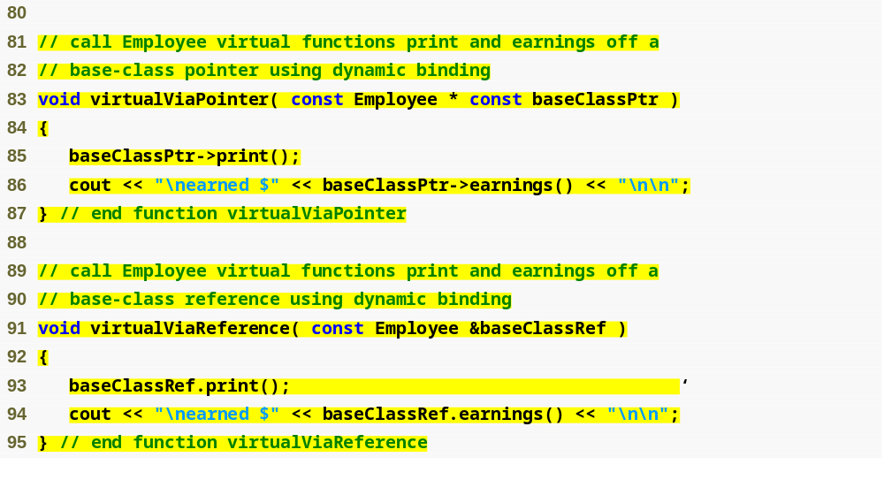
Outline
fig13_23.cpp
(4 of 7)
Using references and pointers cause virtual functions to be invoked polymorphically

Slide 91
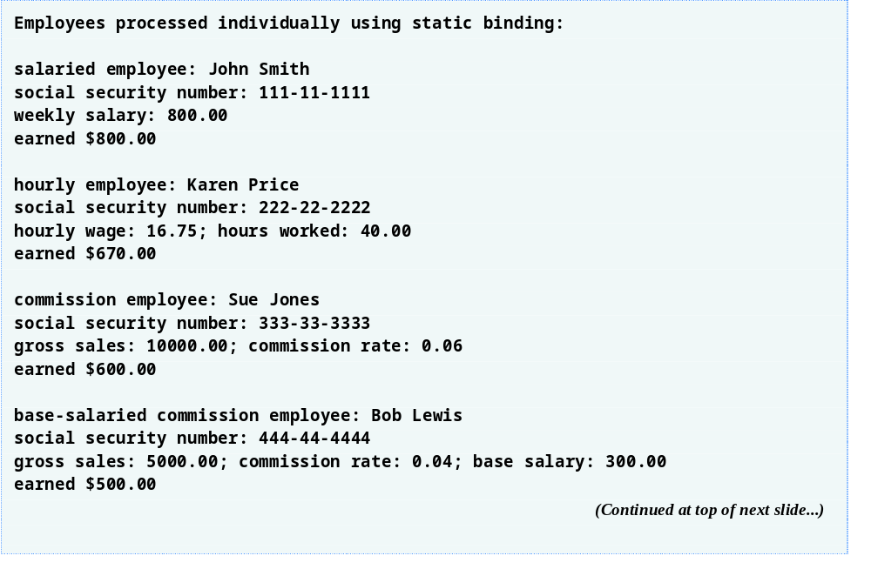
Outline
fig13_23.cpp
(5 of 7)

Slide 92
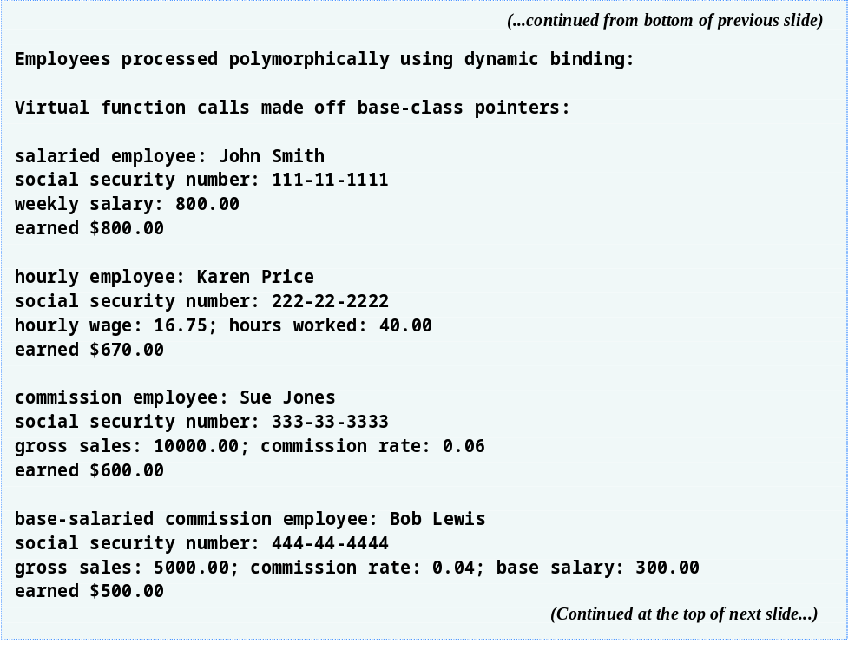
Outline
fig13_23.cpp
(6 of 7)

Slide 93

Outline
fig13_23.cpp
(7 of 7)

Slide 94
13.7 (Optional) Polymorphism, Virtual Functions and Dynamic Binding “Under the Hood”
How can C++ implement polymorphism, virtual functions and dynamic binding internally?
  Three levels of pointers (“triple indirection”)
  Virtual function table (vtable) created when C++ compiles a class that has one or more virtual functions
    First level of pointers
    Contains function pointers to virtual functions
    Used to select the proper function implementation each time a virtual function of that class is called
    If pure virtual, function pointer is set to 0
    Any class that has one or more null pointers in its vtable is an abstract class

Slide 95
13.7 (Optional) Polymorphism, Virtual Functions and Dynamic Binding “Under the Hood” (Cont.)
How can C++ implement polymorphism, virtual functions and dynamic binding internally? (Cont.)
  If a non-pure virtual function were not overridden by a derived class
    The function pointer in the vtable for that class would point to the implemented virtual function up in the hierarchy
  Second level of pointers
    Whenever an object of a class with one or more virtual functions is instantiated, the compiler attaches to the object a pointer to the vtable for that class
  Third level of pointers
    Handles to the objects that receive the virtual function calls

Slide 96
13.7 (Optional) Polymorphism, Virtual Functions and Dynamic Binding “Under the Hood” (Cont.)
How a typical virtual function call executes
  Compiler determines if call is being made via a base-class pointer and that the function is virtual
  Locates entry in vtable using offset or displacement
  Compiler generates code that performs following operations:
    Select the pointer being used in the function call from the third level of pointers
    Dereference that pointer to retrieve underlying object
      Begins with pointer in second level of pointers
    Dereference object’s vtable pointer to get to vtable
    Skip the offset to select the correct function pointer
    Dereference the function pointer to form the “name” of the actual function to execute, and use the function call operator to execute the appropriate function

Slide 97

Fig.13.24 | How virtual function calls work.

Slide 98
Performance Tip 13.1
Polymorphism, as typically implemented with virtual functions and dynamic binding in C++, is efficient. Programmers may use these capabilities with nominal impact on performance.

Slide 99
Performance Tip 13.2
Virtual functions and dynamic binding enable polymorphic programming as an alternative to switch logic programming. Optimizing compilers normally generate polymorphic code that runs as efficiently as hand-coded switch-based logic. The overhead of polymorphism is acceptable for most applications. But in some situations—real-time applications with stringent performance requirements, for example—the overhead of polymorphism may be too high.

Slide 100
Software Engineering Observation 13.11
Dynamic binding enables independent software vendors (ISVs) to distribute software without revealing proprietary secrets. Software distributions can consist of only header files and object files—no source code needs to be revealed. Software developers can then use inheritance to derive new classes from those provided by the ISVs. Other software that worked with the classes the ISVs provided will still work with the derived classes and will use the overridden virtual functions provided in these classes (via dynamic binding).

Slide 101
13.8 Case Study: Payroll System Using Polymorphism and Run-Time Type Information with Downcasting, dynamic_cast, typeid and type_info
Example: Reward BasePlusCommissionEmployees by adding 10% to their base salaries
Must use run-time type information (RTTI) and dynamic casting to “program in the specific”
  Some compilers require that RTTI be enabled before it can be used in a program
    Consult compiler documentation

Slide 102
13.8 Case Study: Payroll System Using Polymorphism and Run-Time Type Information with Downcasting, dynamic_cast, typeid and type_info (Cont.)
dynamic_cast operator
  Downcast operation
    Converts from a base-class pointer to a derived-class pointer
  If underlying object is of derived type, cast is performed
    Otherwise, 0 is assigned
  If dynamic_cast is not used and attempt is made to assign a base-class pointer to a derived-class pointer
    A compilation error will occur

Slide 103
13.8 Case Study: Payroll System Using Polymorphism and Run-Time Type Information with Downcasting, dynamic_cast, typeid and type_info (Cont.)
typeid operator
  Returns a reference to an object of class type_info
    Contains the information about the type of its operand
    type_info member function name
      Returns a pointer-based string that contains the type name of the argument passed to typeid
  Must include header file <typeinfo>

Slide 104

Outline
fig13_25.cpp
(1 of 4)

Slide 105

Outline
fig13_25.cpp
(2 of 4)
Create employee objects, only one of type BasePlusCommissionEmployee
Downcast the Employee pointer to a BasePlusCommissionEmployee pointer

Slide 106

Outline
Determine if cast was successful
fig13_25.cpp
(3 of 4)
If cast was successful, modify base salary
Use typeid and function name to display object types

Slide 107

Outline
fig13_25.cpp
(4 of 4)

Slide 108
13.9 Virtual Destructors
Nonvirtual destructors
  Destructors that are not declared with keyword virtual
  If a derived-class object is destroyed explicitly by applying the delete operator to a base-class pointer to the object, the behavior is undefined
virtual destructors
  Declared with keyword virtual
    All derived-class destructors are virtual
  If a derived-class object is destroyed explicitly by applying the delete operator to a base-class pointer to the object, the appropriate derived-class destructor is called
    Appropriate base-class destructor(s) will execute afterwards

Slide 109
Good Programming Practice 13.2
If a class has virtual functions, provide a virtual destructor, even if one is not required for the class. Classes derived from this class may contain destructors that must be called properly.

Slide 110
Common Programming Error 13.5
Constructors cannot be virtual. Declaring a constructor virtual is a compilation error.

Slide 111
13.10 (Optional) Software Engineering Case Study: Incorporating Inheritance into the ATM System
UML model for inheritance
  The generalization relationship
    The base class is a generalization of the derived classes
    The derived classes are specializations of the base class
  Pure virtual functions are abstract operations in the UML
  Generalizations and abstract operations are written in italics
Transaction base class
  Contains the functions and data members BalanceInquiry, Withdrawal and Deposit have in common
    execute function
    accountNumber data member

Slide 112

Fig.13.26 | Attributes and operations of classes BalanceInquiry, Withdrawal and Deposit.

Slide 113

Fig.13.27 | Class diagram modeling generalization relationship between base class Transaction and derived classes BalanceInquiry, Withdrawal and Deposit.

Slide 114

Fig.13.28 | Class diagram of the ATM system (incorporating inheritance). Note that abstract class name Transaction appears in italics.

Slide 115
13.10 (Optional) Software Engineering Case Study: Incorporating Inheritance into the ATM System (Cont.)
Incorporating inheritance into the ATM system design
  If class A is a generalization of class B, then class B is derived from class A
  If class A is an abstract class and class B is a derived class of class A, then class B must implement the pure virtual functions of class A if class B is to be a concrete class

Slide 116

Fig.13.29 | Class diagram after incorporating inheritance into the system.

Slide 117
Software Engineering Observation 13.12
A complete class diagram shows all the associations among classes and all the attributes and operations for each class. When the number of class attributes, operations and associations is substantial (as in Fig. 13.28 and Fig. 13.29), a good practice that promotes readability is to divide this information between two class diagrams—one focusing on associations and the other on attributes and operations. However, when examining classes modeled in this fashion, it is crucial to consider both class diagrams to get a complete view of the classes. For example, one must refer to Fig. 13.28 to observe the inheritance relationship between Transaction and its derived classes that is omitted from Fig. 13.29.

Slide 118

Outline
Withdrawal.h
(1 of 1)
Class Withdrawal inherits from Transaction

Slide 119

Outline
Withdrawal.h
(1 of 1)
Class Withdrawal inherits from Transaction

Slide 120

Outline
Transaction.h
(1 of 1)
Transaction is an abstract class, contains a pure virtual function
Declare pure virtual function execute

